Slide 1





Cooperative Fire Services

Slide 2
Today’s Discussion
Who are we?
Why did we consolidate and who started this?
What was the process leading to the consolidation?
What did we initially create?
What were the challenges?
What are the benefits?
What do we look like today?

Slide 3
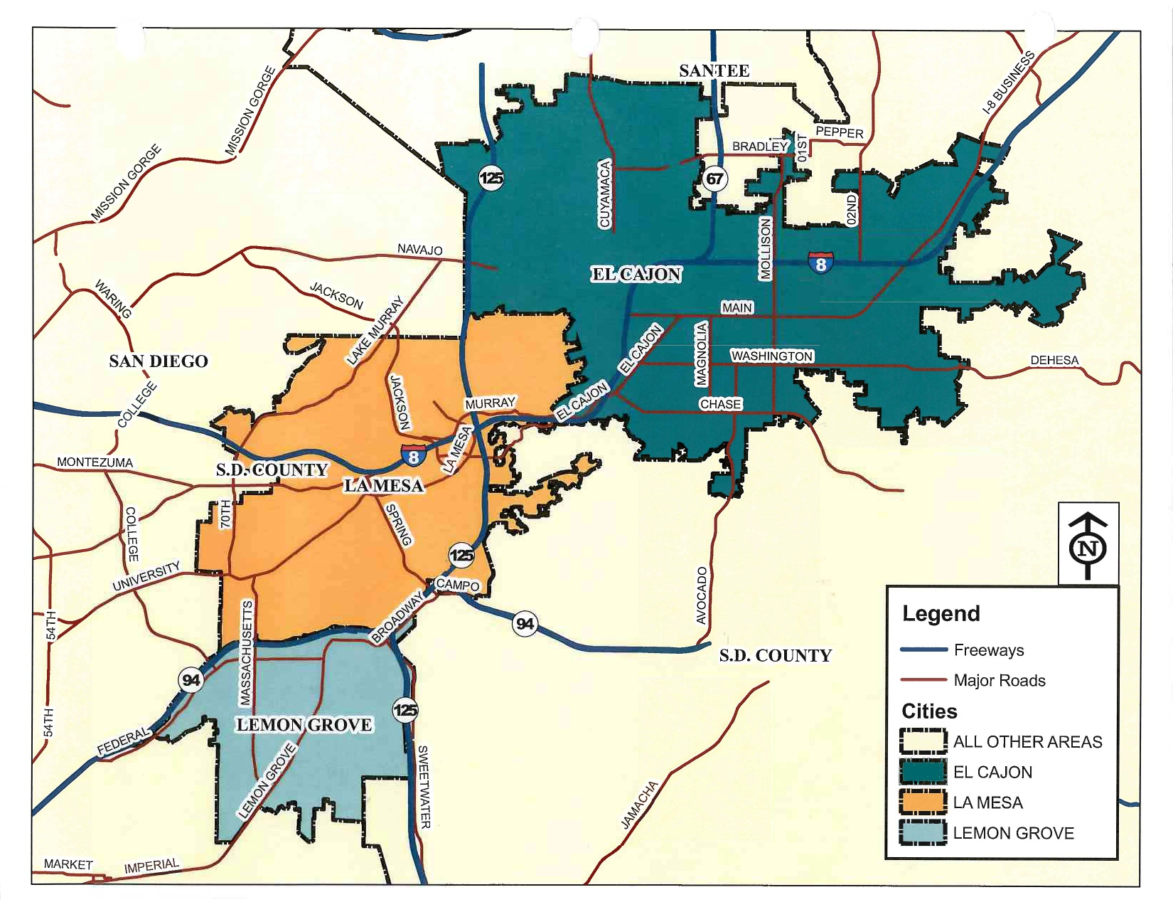
Who are we?
  El Cajon:
  Area: 14.43 sq miles
  Population: 100,460
  La Mesa:
  Area: 9.117 sq miles
  Population: 58,244
  Lemon Grove:
  Area: 3.88 sq miles Population: 25,554

Slide 4
Why Did We Consolidate?
Faced with global fiscal crisis
Reduced city revenues
Increasing cost of services, personnel and consumables
Current and future vacancies
Existing strong relationship and trust
Experience with cooperative efforts
Cost containment while enhancing services and capabilities

Slide 5
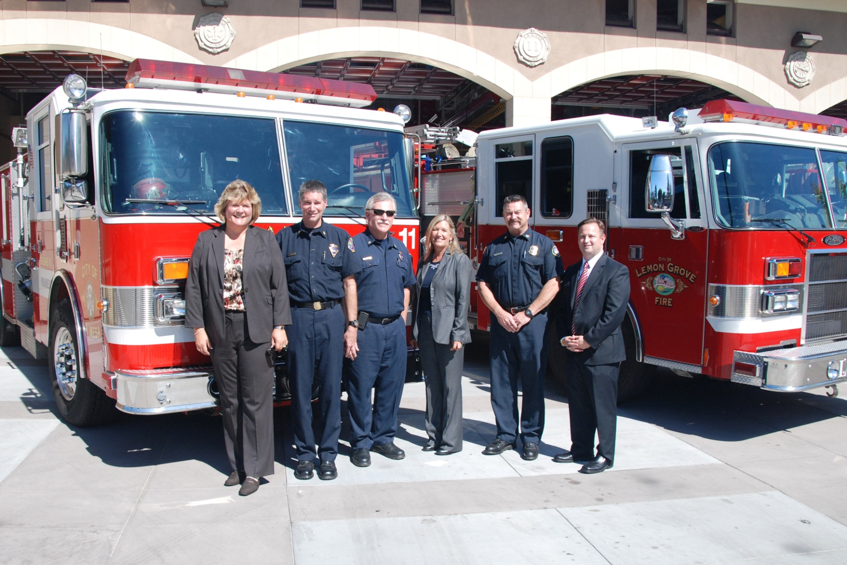
Who Started This Process?

Slide 6
Three City Managers
Kathi Henry– El Cajon
Sandra Kerl– La Mesa
Graham Mitchell – Lemon Grove
Three Fire Chiefs
Mike Scott – El Cajon
Dave Burk – La Mesa
Tim Laff – Lemon Grove

Slide 7
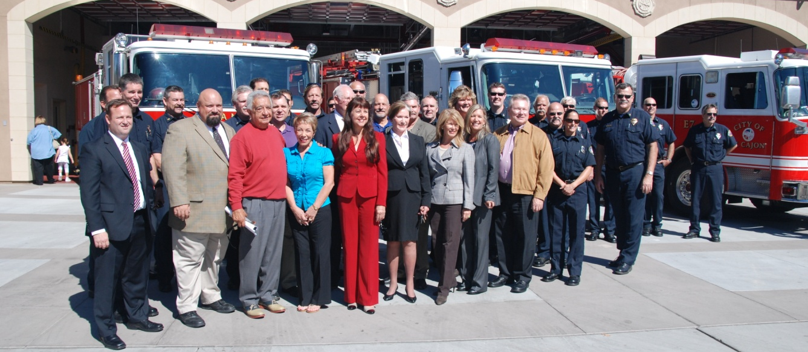
The Process
The Stakeholders
Elected Officials
City Managers
Fire Chiefs
Department Directors
Staff
Labor

Slide 8
Working Groups:
Governance
Administration
Fire Operations/Training
EMS
Fire Prevention
Emergency Preparedness
Fleet/Facilities/Equipment
Finance
Labor

Slide 9
The Working Groups
All Working groups were chaired by a Fire Chief
Three cities were represented equally in each group
Tasks and timelines were established
Labor was represented in working groups
Quarterly detailed report of progress and status
Working groups met for 12 months prior to formation of JPA

Slide 10
Governance Models
Several governance models were evaluated:
  Contract Service Model
  Joint Powers Agreement
  Joint Powers Agreement as a single agency
  Fire District
  Fire Authority

Slide 11
Governance Models - continued
Pros and cons were identified for each of the governance models
All cities agreed upon a Joint Powers Agreement because:
  Partnership with control
  One management team
  City Manager Executive Team with Fire Chief
  Cost containment

Slide 12
Governance Models - continued
  No LAFCO process
  Allows future MOU merging
  Creates operational efficiencies
  Consolidates functional areas
  Singular set of Policies & Procedures
  Additional agencies can easily be added
  Future formation of Authority possible

Slide 13
What did we immediately create?
Joint Exercise of Powers Agreement
City Manager Executive Committee
Shared management team
Cost allocation formula
Personnel exchange and resource sharing program
Employees still work for their individual city
Common policies and procedures

Slide 14
Reconciliation Formula
How to determine the formula…..who pays what?
Assessed values of jurisdictions?
Population?
Personnel?
Calls?
Square miles?

Slide 15
Reconciliation Formula - Adopted
Our assessment is calculated on two parts as follows:
1. The population of the member city as of January 1st of each year (weight 50%)
2. The total number of incidents for the member city for the previous calendar year as provided by dispatch (weight 50%)

Slide 16
Reconciliation Formula - continued
Original Reconciliation included: | Today’s Reconciliation has added:
Salaries & benefits of Chief Officers and Management Analyst | Salaries & benefits for all Admin Staff
 | Salaries & benefits for all FP Staff
 | Memberships/dues/subscriptions for JPA Staff
 | Training for JPA Staff
 | Shared training expenses for sworn
 | Cell phones for JPA staff
 | JPA Management Staff vehicle milage
 | Telestaff software agreement (for joint rostering)
 | FireHouse Software Agreement (RMS)

Slide 17


Our Timeline
2009
Investigation Committees Formed
Working Groups Established:
  Elected Officials
  City Managers
  Fire Chiefs
  Staff
  Working Groups
2010
JPA Launched
CM Exec. Committee Formed
Management Common Identity
Common Emergency OPS Coordination
1st set of policies and procedures
2011
Common Identity for all personnel
Consolidated FP
Consolidated Training
Common Equipment Specifications for all future purchases
2nd set of policies and procedures
2012
ISO Rating Improved
Non-Safety Fire Marshal
Consolidated Admin Functions
Common Grant Acquisitions
3rd set of policies and procedures
2013
Joint Training Funds
Funded EMPP Position
Common Apparatus Identity
4th set of policies and procedures
2014
Common set of emergency Operation Plans
Common fire code adoption process
Expansion of fire prevention division
Expanded the reserve program to three cities
5th set of policies and procedures
Notes:
Add from notes slide

Slide 18
Prior to JPA |  |  | HF&R JPA
EL CAJON
Fire Chief | 1 |  | Fire Chief | 1
Division Chief | 2 |  | Deputy Chief | 2
Battalion Chief | 3 |  | Division Chief | 2
Deputy Fire Marshal (Captain Acting) | 1 |  | Battalion Chief | 5
Management Analyst | 1 |  | Fire Marshal (changed to non-safety) | 1
Secretary | 1 |  | Deputy Fire Marshal | 1
Total | 9 |  | Fire Inspector | 1
 |  |  | Fire Inspector - part time | 2
LA MESA |  |  | Disaster Preparedness Coordinator | 1
Fire Chief | 1 |  | Management Analyst | 1
Division Chief | 4 |  | Administrative Analyst | 1
Fire Inspector | 2 |  | Administrative Assistant | 1
Administrative Coordinator | 1 |  | Secretary | 1
Total | 8 |  | Grand Total | 20
LEMON GROVE
Fire Chief | 1
Deputy Chief | 1
Division Chief | 1
Fire Inspector - part time | 2
Secretary | 1
Total | 6
Grand Total | 23
New Positions in JPA

Slide 19
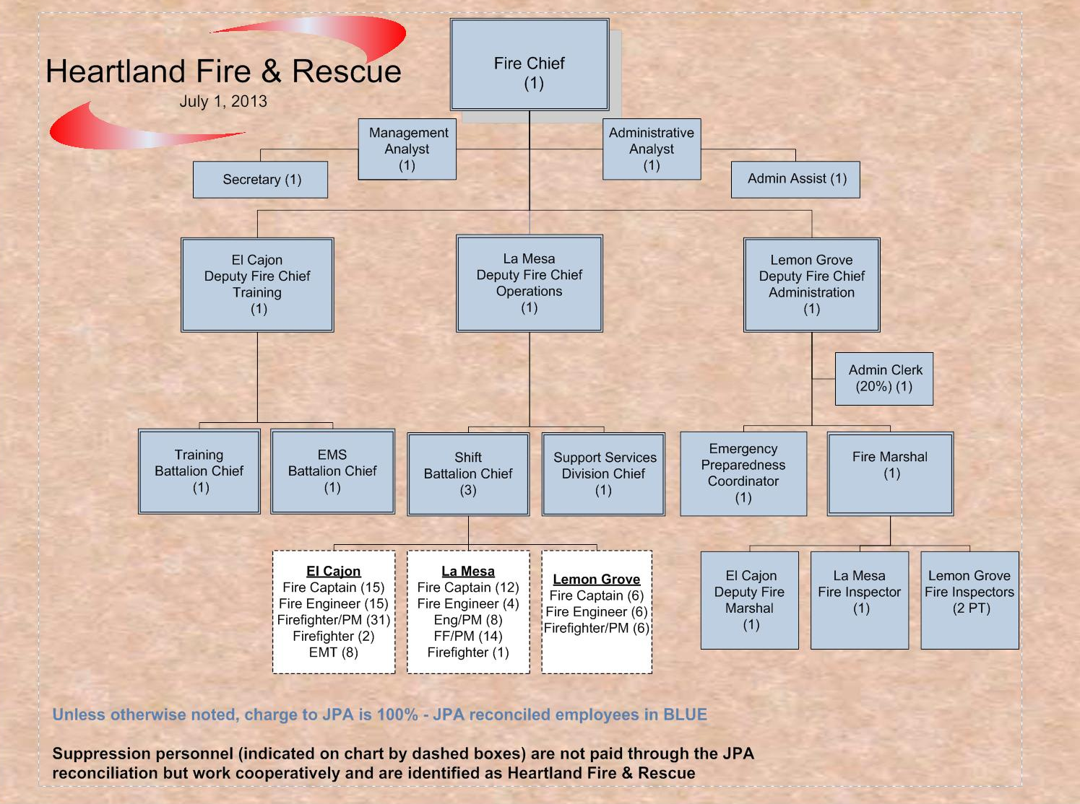
Notes:
Need to update

Slide 20

What Were The Challenges?
Cross-city acceptance
Perceived potential for loss of control
Loss of individual identity=
Cultural differences=
Learning how to conduct
business in three different cities
Resistance to change

Slide 21
Experiencing The Benefits?
Cost containment
Increased regional approach of Fire and EMS delivery
Better response capabilities (24 hour Battalion Chief coverage all three cities)
Improved and shared training programs
Common set of City Emergency Planning Documents
Standardized equipment and apparatus
Large resource pool of like-trained employees for vacancies in all three cities

Slide 22
Benefits - continued
EOC and Disaster Preparedness through a shared Community Emergency Preparedness Program Manager
Sharing of Reserve Apparatus fleet
Shared Public Information and Social Media champagne
Joint recruitment and promotional processes
Common set of Administrative Policies and Procedures
Common set of Fire Code adoptions for all three cities
Consolidated Grant Management
Unique JPA agreement allows for maintaining level of individual City control
Shared Mission, Vision, Values and Goals

Slide 23
Secrets we learned to managing or preventing some challenges
Clear picture of vision and benefits
Help everyone understand benefits
Create an Organizational Chart early
Create opportunities to combine work force of the three cities very early
Ensure a level of city control is maintained
Cost sharing formula must be fair
Don’t underestimate identity issues

Slide 24
Secrets - continued
COMMUNICATE as much as possible
Celebrate successful efforts
Recognize challenges with positive outlook
Labor MOU is difficult hurdle
Support your Fire Chief!

Slide 25

Today’s Shared Identity

Slide 26
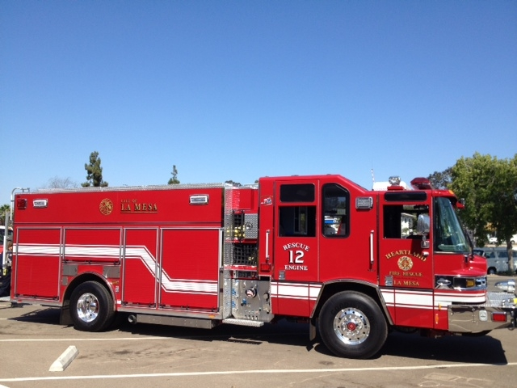
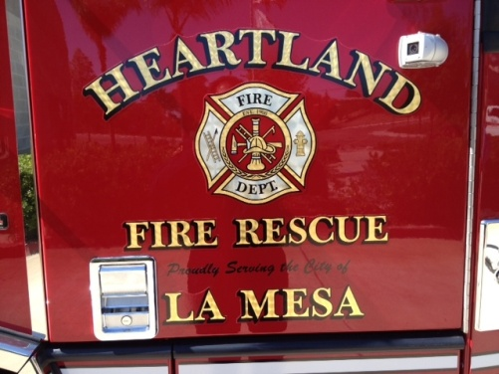
Today’s Standardized Equipment

Slide 27
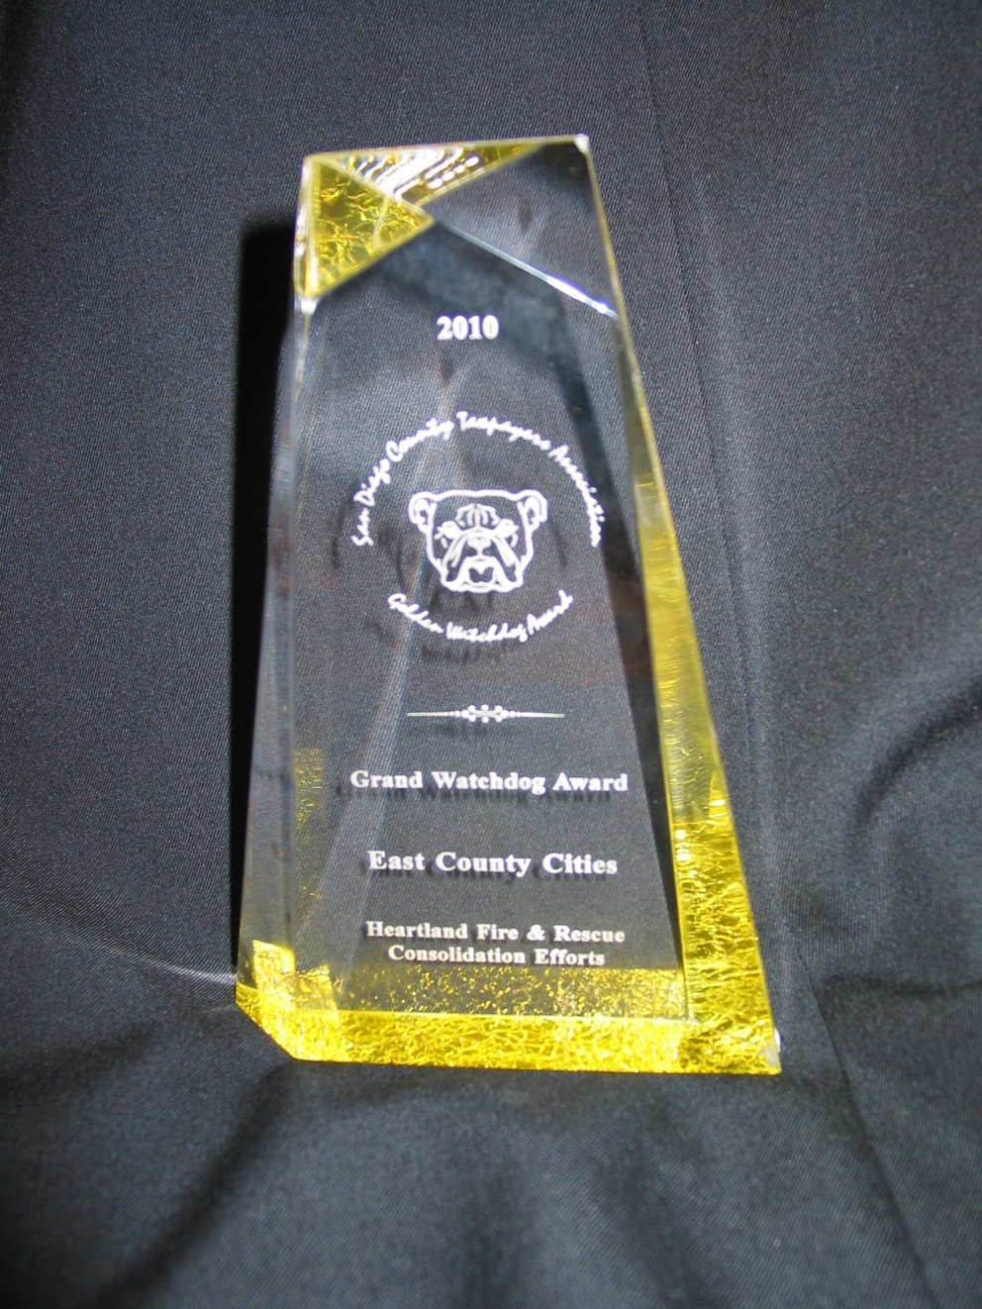
San Diego County Taxpayers Association
Grand Golden Watchdog Award
“Honors programs that exemplify good government practices and efficient use of taxpayer dollars”

Slide 28
Heartland Fire & Rescue
Thank You

