Slide 1
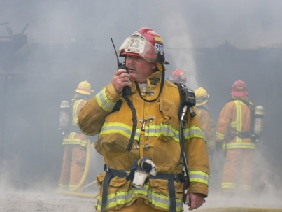
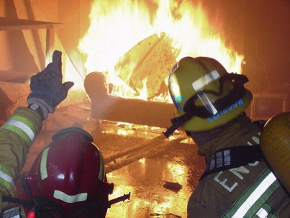
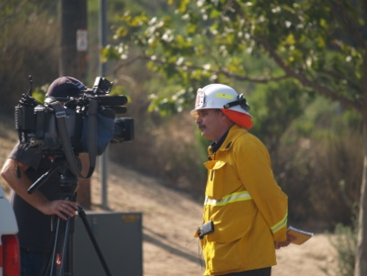
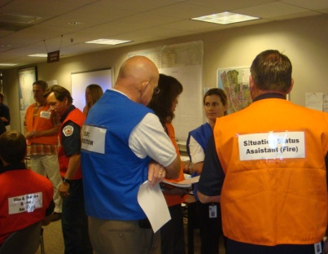
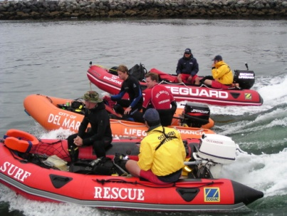
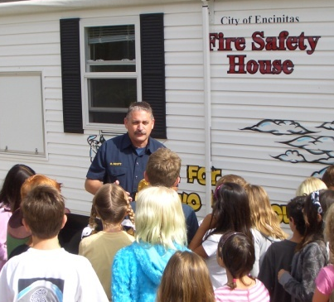
San Diego LAFCO Workshop
Local Fire Protection and Emergency Medical Service Issues
Presenter
David Ott – City of Solana Beach City Manager

Slide 2
What Is A Sustainable Cost Effective Level Of Service?
Agency Dependent
Revenue
Source and Sustainability of Revenues
Cost of Services – Today & Going Forward
  Employees
  Benefits
  Equipment and Infrastructure
The Public
Notes:
Ultimately the public decides

Slide 3
Is There A Need for Shared Service Agreements?
Yes
Sharing the functions of organizational direction and control, supervision of operations, training, fire prevention, EMS, administrative, fiscal management and disaster preparedness can provide effective leadership to multiple agencies, eliminating redundancy, duplication of effort and provide opportunities for current cost savings and an increased level of service for each party, while avoiding for each party the full cost of independent fire administrations.
Notes:
Depends on individual agencies circumstances
Many forms of Shared Service Agreements – Operations – Services such as Apparatus Maintenance; Equipment Maintenance; Support Services (Prevention, Admin HR, Finance/Budget)
Public/Private – CSA 17 EMS

Slide 4
What Are The Areas Of Potential Resistance When Deciding Whether To Pursue Shared Service Agreements?
Key Stakeholders
  The Legislative Board
  The Community
  Employees
Notes:
The need has to be communicated
Benefits – What’s in it for me?
LEGAL
Workers Compensation
Comprehensive Liability Insurance
Contract
Indemnification (hold harmless)
60 Days “Opt Out Clause”
FINANCIAL
At or below other reasonable options
OPERATIONAL
Improve operational efficiencies and effectiveness
POLITICAL
Maintain control
Own Fire Dept
Increase Efficiencies

Slide 5
What Is The Role Of Elected Officials/Policy Makers?
Vision
Champion
Support
Notes:
Look out to the future. Is the current model sustainable in the long run?
Provide direction
Work with your staff, consultants – develop a plan
Make sure all the key stakeholders are in the discussion and development of the plan
Be the champion of the plan to the public – Communicate
You can never answer every question. No such thing as perfect. Move forward and support as it evolves to address issues not anticipated

Slide 6
Questions?

Slide 8
Financial and Operational
Benefits 0f the FMS Agreement
Save Money
Cost Containment
Provides Enhanced Service
Economy of Scale
Operational Consistency and Coordination
Emergency Planning Coordination
Reduces Duplications
Increases Communications
Short and Long Term Benefits

