Slide 1
Overview of
National/Regional/State
Fire/EMS Issues
Bill Metcalf, Fire Chief
North County Fire protection District
Immediate Past President, International Association of Fire Chiefs

Slide 2
Current Status of Fire/EMS Services
Economic Recovery

Slide 3
Current Status of Fire/EMS Services
Economic Recovery
Significantly ‘Damaged’ Fire Departments

Slide 4
Current Status of Fire/EMS Services
Economic Recovery
Significantly ‘Damaged’ Fire Departments
Generally Unprepared for Recovery

Slide 5
Current Status of Fire/EMS Services
Economic Recovery
Significantly ‘Damaged’ Fire Departments
Generally Unprepared for Recovery
Wicked Problems

Slide 6
Wicked Problems in the Fire Service
Unable to Justify the Cost/Effectiveness of Service

Slide 7
Wicked Problems in the Fire Service
Unable to Justify the Cost/Effectiveness of Service
Inadequate Date and Analysis To Evaluate What we Do

Slide 8
Wicked Problems in the Fire Service
Unable to Justify the Cost/Effectiveness of Service
Inadequate Date and Analysis To Evaluate What we Do
Unable to Explain/Justify Deployment and Staffing

Slide 9
Wicked Problems in the Fire Service
Unable to Justify the Cost/Effectiveness of Service
Inadequate Date and Analysis To Evaluate What we Do
Unable to Explain/Justify Deployment and Staffing
Changing Culture

Slide 10
Wicked Problems in the Fire Service
Unable to Justify the Cost/Effectiveness of Service
Inadequate Date and Analysis To Evaluate What we Do
Unable to Explain/Justify Deployment and Staffing
Changing Culture
Political Acumen

Slide 11
Cooperative Service Models
Consolidation

Slide 12
Cooperative Service Models
Consolidation
Joint Powers Authority (or Agreement)

Slide 13
Cooperative Service Models
Consolidation
Joint Powers Authority (or Agreement)
Shared Services

Slide 14
Cooperative Service Models
Consolidation
Joint Powers Authority (or Agreement)
Shared Services
Shared Facilities

Slide 15
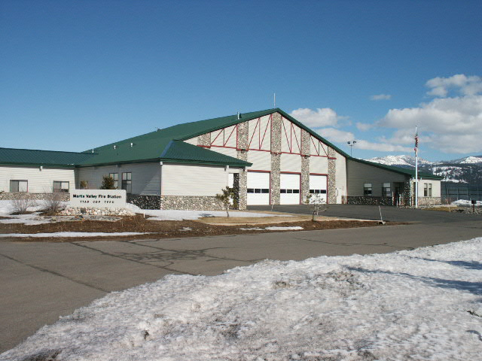
Truckee Fire District Station 96

Slide 16
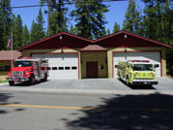
Grass Valley/Nevada County Joint Station

Slide 17
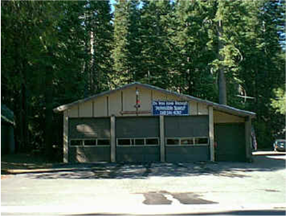
North Tahoe Fire Protection District Homewood Station

Slide 18
Cooperative Service Models
Consolidation
Joint Powers Authority (or Agreement)
Shared Services
Shared Facilities
Public/Private Partnerships

Slide 19
Cooperative Service Models
Consolidation
Joint Powers Authority (or Agreement)
Shared Services
Shared Facilities
Public/Private Partnerships
Public Safety Model

Slide 20
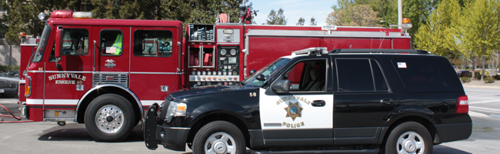
Sunnyvale Department of Public Safety

Slide 21
Challenges/Obstacles to Shared Services
Local Control

Slide 22
Challenges/Obstacles to Shared Services
Local Control
Revenue/Property Tax Allocation

Slide 23
Challenges/Obstacles to Shared Services
Local Control
Revenue/Property Tax Allocation
Consolidation of Workforce/Labor Agreements

Slide 24
Challenges/Obstacles to Shared Services
Local Control
Revenue/Property Tax Allocation
Consolidation of Workforce/Labor Agreements
It’s Complicated/Expensive

Slide 25
Trends in Service Sustainability
Economic Recovery has Reduced the Motivation

Slide 26
Trends in Service Sustainability
Economic Recovery has Reduced the Motivation
More Divorces than Marriages

Slide 27
Trends in Service Sustainability
Economic Recovery has Reduced the Motivation
More Divorces than Marriages
Public Safety model Falling out of Favor

Slide 28
Trends in Service Sustainability
Economic Recovery has Reduced the Motivation
More Divorces than Marriages
Public Safety model Falling out of Favor
Some Isolated Successful Initiatives Underway

