Slide 1

Commission Meeting
Local Agency Formation Commission
San Diego County
LAFCO
A Subdivision of the State
May 6, 2024

Slide 2
Proposed “Sky Ranch Change of Organization”
Item 7a | Public Hearing
  Resolution by Padre Dam MWD
  Detachment from Helix WD
  Conforming SOI Actions
Background
  Detachment of 26.5 acres within City of Santee from Helix WD
  Developed w/27 single-family homes & ancillary Improvements
  Eliminate overlap of services between Padre Dam MWD & Helix WD
  Make Padre Dam MWD authorized water service provider

Slide 3
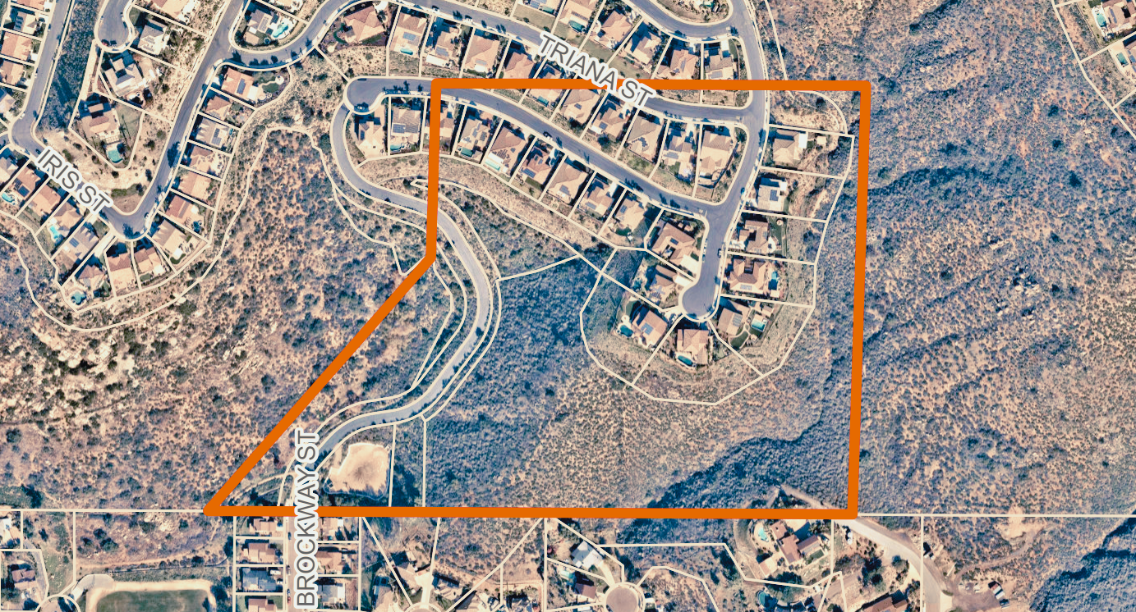
Proposed “Sky Ranch Change of Organization”
Item 7a | Public Hearing

Slide 4
Proposed “Sky Ranch Change of Organization”
Item 7a | Public Hearing
  Shere-of-Influence amendment needed
  Policy L-106 (MSR 5+ years old)
  Waiver is appropriate, modest project size
Qualifier
Recommendation
a) Approve proposal as submitted w/SOI amendment
b) Approve standard conditions & delegate protest to EO
c) Approve exemption findings as specified under CEQA

Slide 5
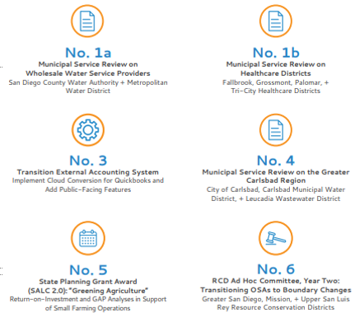
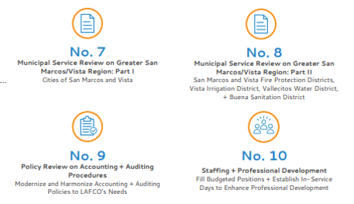
Final Workplan & Budget
Item 7b | Public Hearing

Slide 6
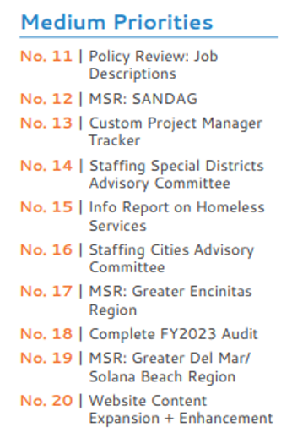
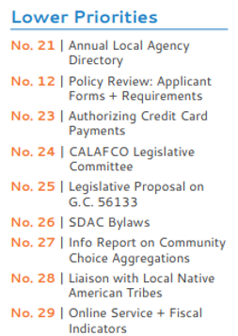
Final Workplan & Budget
Item 7b | Public Hearing

Slide 7
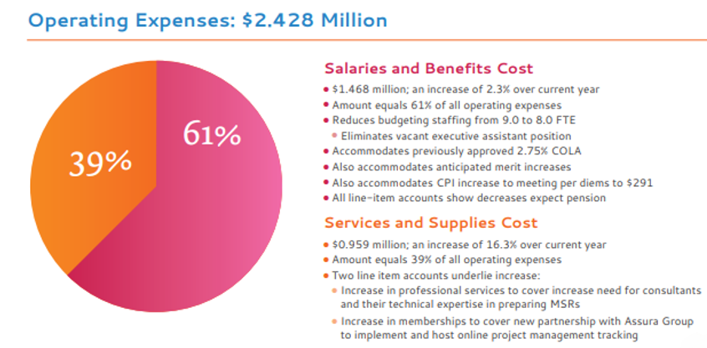
Final Workplan & Budget
Item 7b | Public Hearing

Slide 8
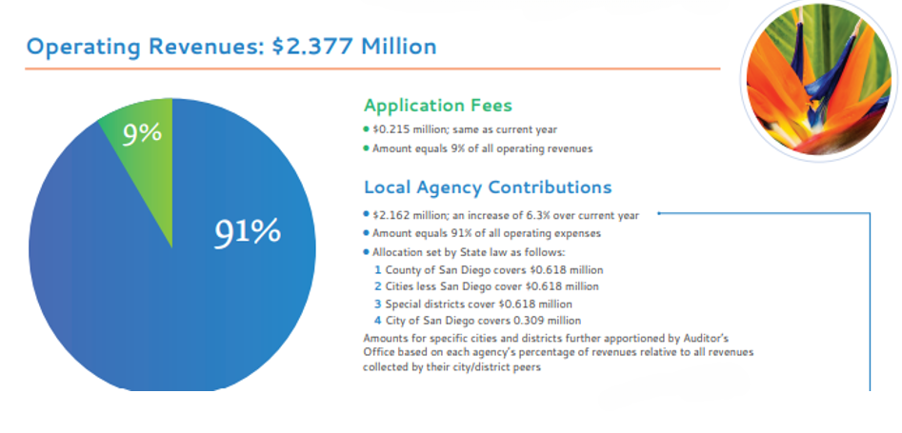
Final Workplan & Budget
Item 7b | Public Hearing

Slide 9
Proposed Policy on Out-of-Agency Services
Item 8b | Business
Big 5
a) Make explicit Commission’s policy preference to take up out-of-agency service requests on an exception basis when otherwise merited service expansions cannot be accommodated through preferred annexations.
b) Establishes local definitions on what constitutes “new” and “extended” services.
c) Expands on statutory exemptions and includes local exceptions where formal LAFCO approval is not needed.
d) Provides a no-cost process for local agencies to work with LAFCO in determining exemption eligibility.
e) Recasts the Executive Officer’s administrative approval to only apply to health and safety threats involving water and wastewater; all other requests would now go to the Commission…

Slide 10
Proposed Policy on Out-of-Agency Services
Item 8b | Business
Requested Revisions
Add to Section 3(c) with iii:
“Should the Executive Officer determine an inquiry does qualify for exemption, any city or special district that contains – whether the sphere of influence or jurisdictional boundary – the affected territory shall be given immediate written notice and may appeal directly to the full Commission. The appeal request must be made in writing and signed by the city manager or special district manager. The appeal must be received within three business days of receiving the original notice from the Executive Officer.”

Slide 11
Proposed Policy on Out-of-Agency Services
Item 8b | Business
Requested Revisions
Amend Section 5 with the addition of “b)”
“All approval requests for out-of-agency services received under this part shall immediately be forwarded by LAFCO to any other city or special district whose sphere of influence or jurisdictional boundary contains the affected territory.”
Amend Section 7 with the addition of “b)”:
“Should an out-of-agency service request be approved, any other city or special district whose sphere of influence or jurisdictional boundary contains the affected territory may request reconsideration consistent with Rule 3.4(2).”

Slide 12
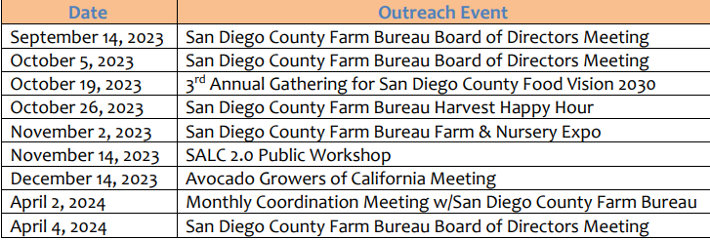
SALC 2.0 Updated Outreach & Education Plan
Item 8c | Business
Involvement To-date

Slide 13




SALC 2.0 Updated Outreach & Education Plan
Item 8c | Business
Future Engagement Plans
  Public Workshops
  Producer Summit
  Working group meetings involving local producers & technical experts
  Interviews with local agencies & jurisdictions

