Slide 2
San Diego County
Local Agency Formation Commission
(LAFCO)
Commission Meeting
March 4th, 2024

Slide 4
San Diego County
Local Agency Formation Commission
(LAFCO)
Commission Meeting
March 4th, 2024

Slide 5
Agenda Item 3
Commendation for former Commissioner Andy Vanderlaan

Slide 6
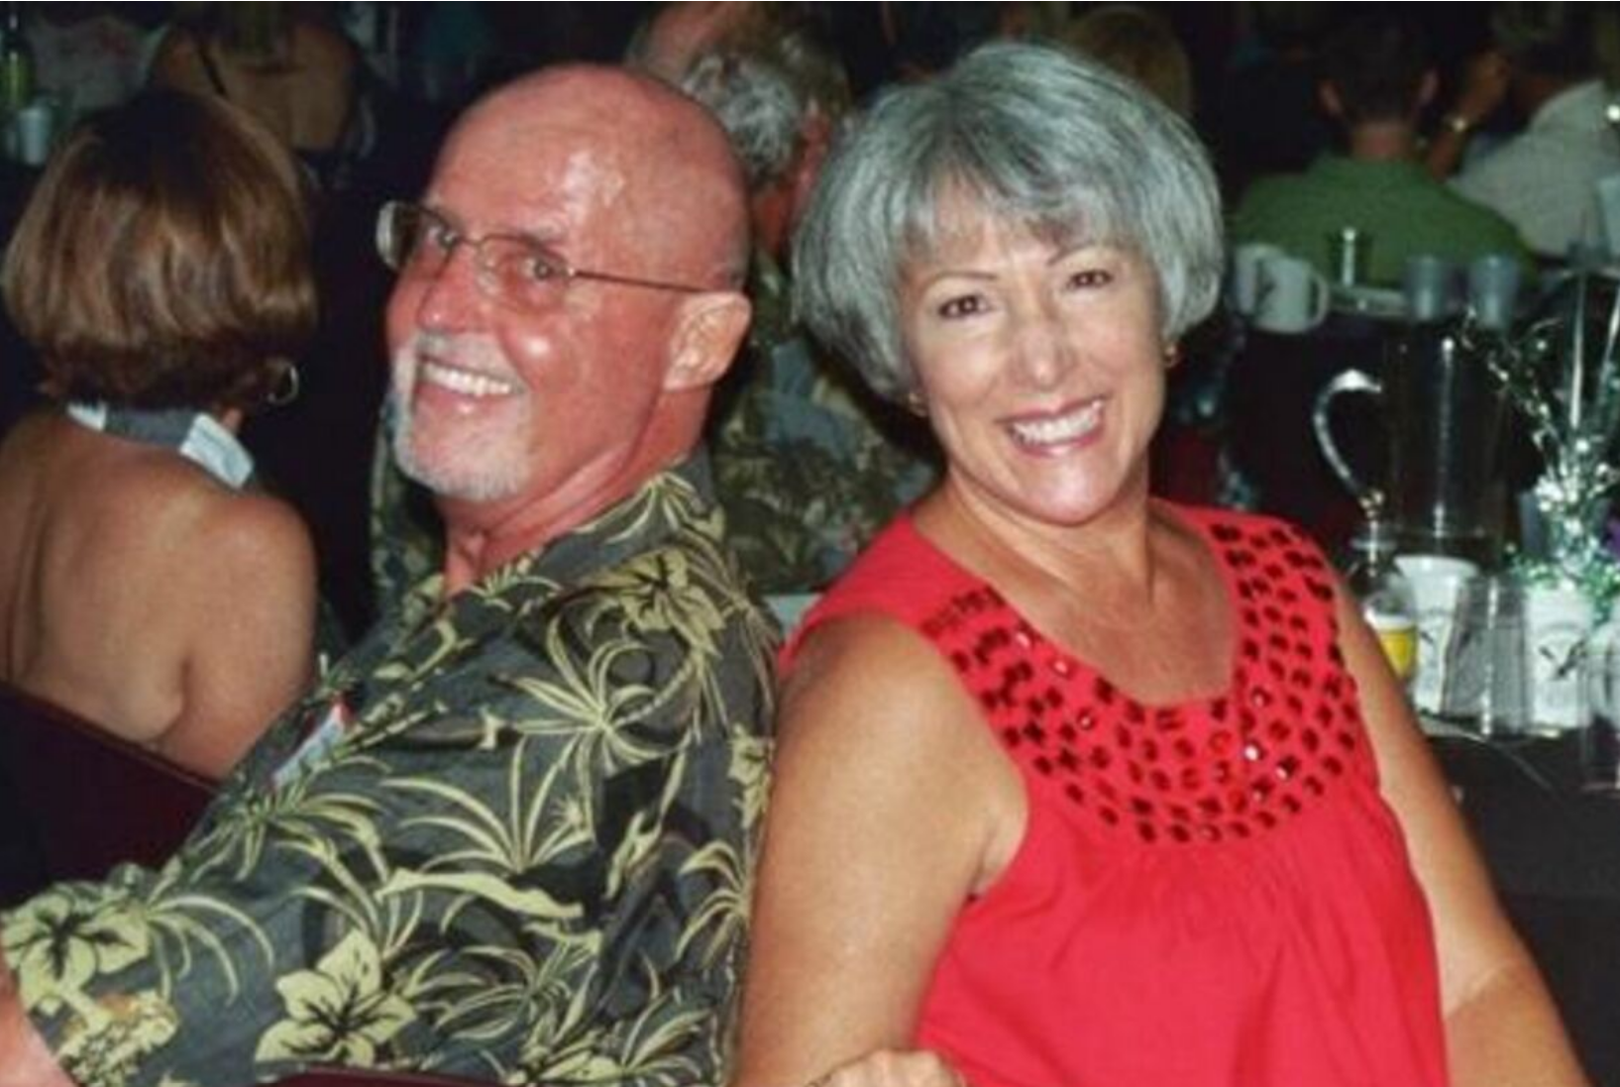
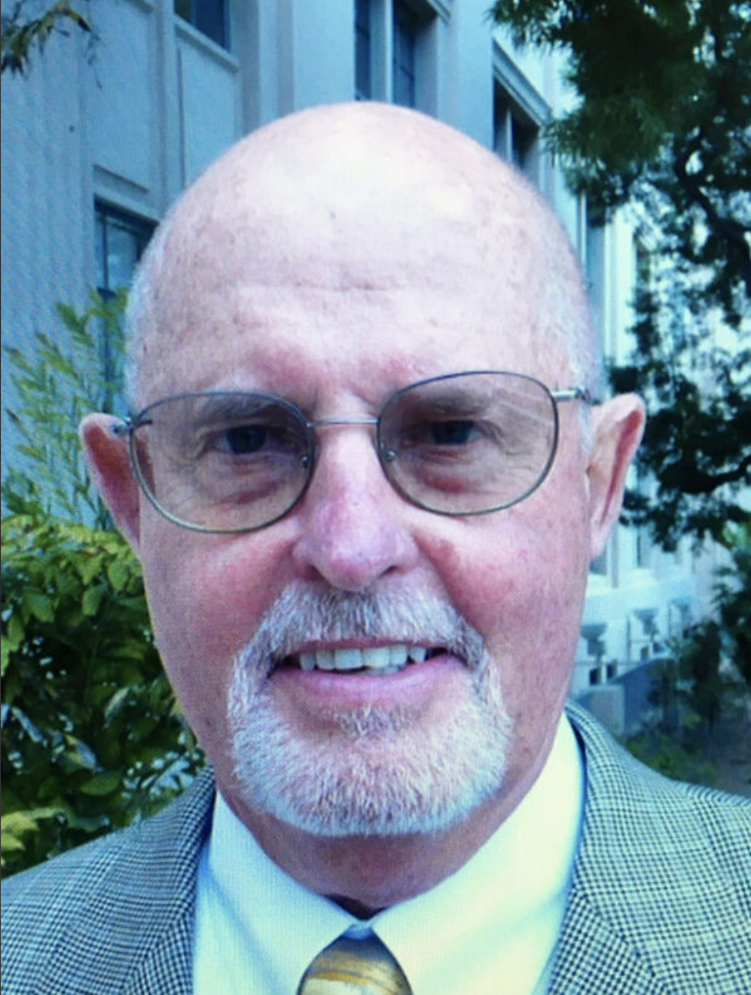
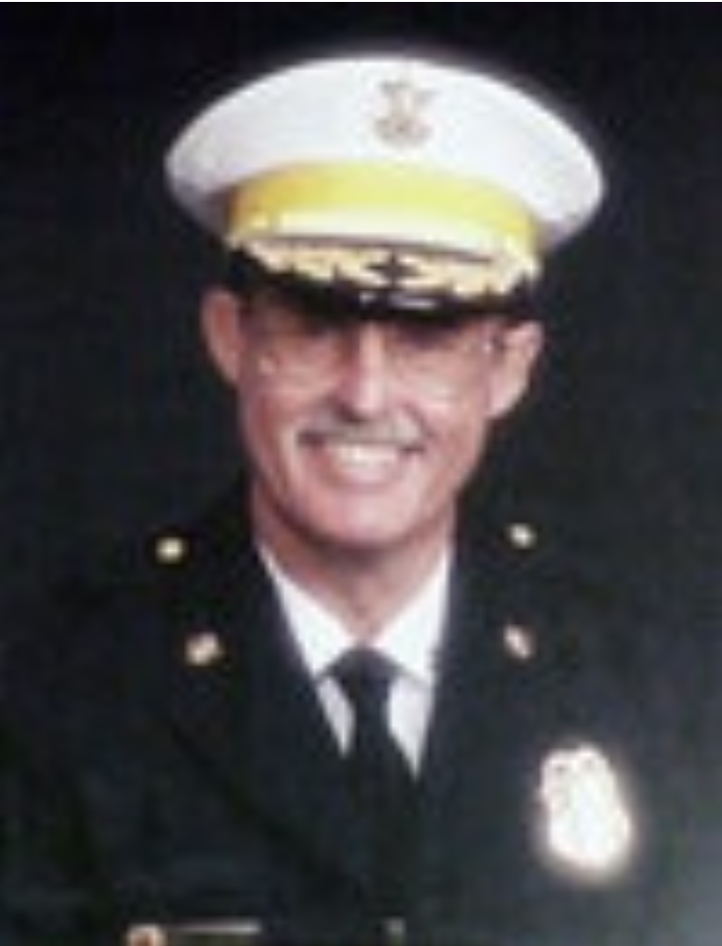

Slide 7
THANK YOU!!

Slide 8
San Diego County
Local Agency Formation Commission
(LAFCO)
Commission Meeting
March 4th, 2024

Slide 9
Agenda Item 7a
“Tucker – Valley Road Reorganization”

Slide 10
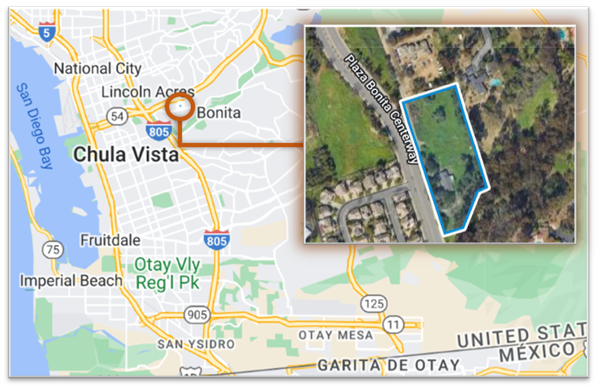
Agenda Item 7a
“Tucker – Valley Road Reorganization”
Annexation to National City with Concurrent Detachments from South Bay ID, Bonita-Sunnyside FPD, and CSA No. 135, and Related Sphere of Influence Amendment (RO23-01)

Slide 11
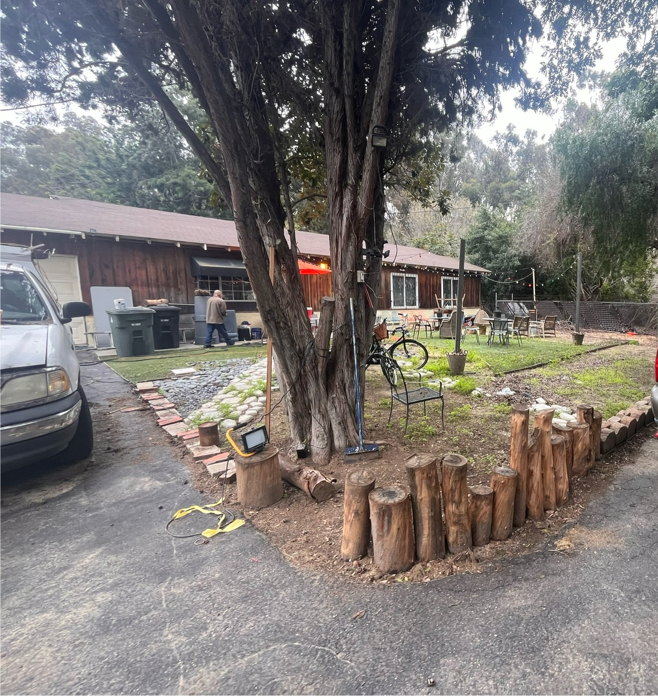
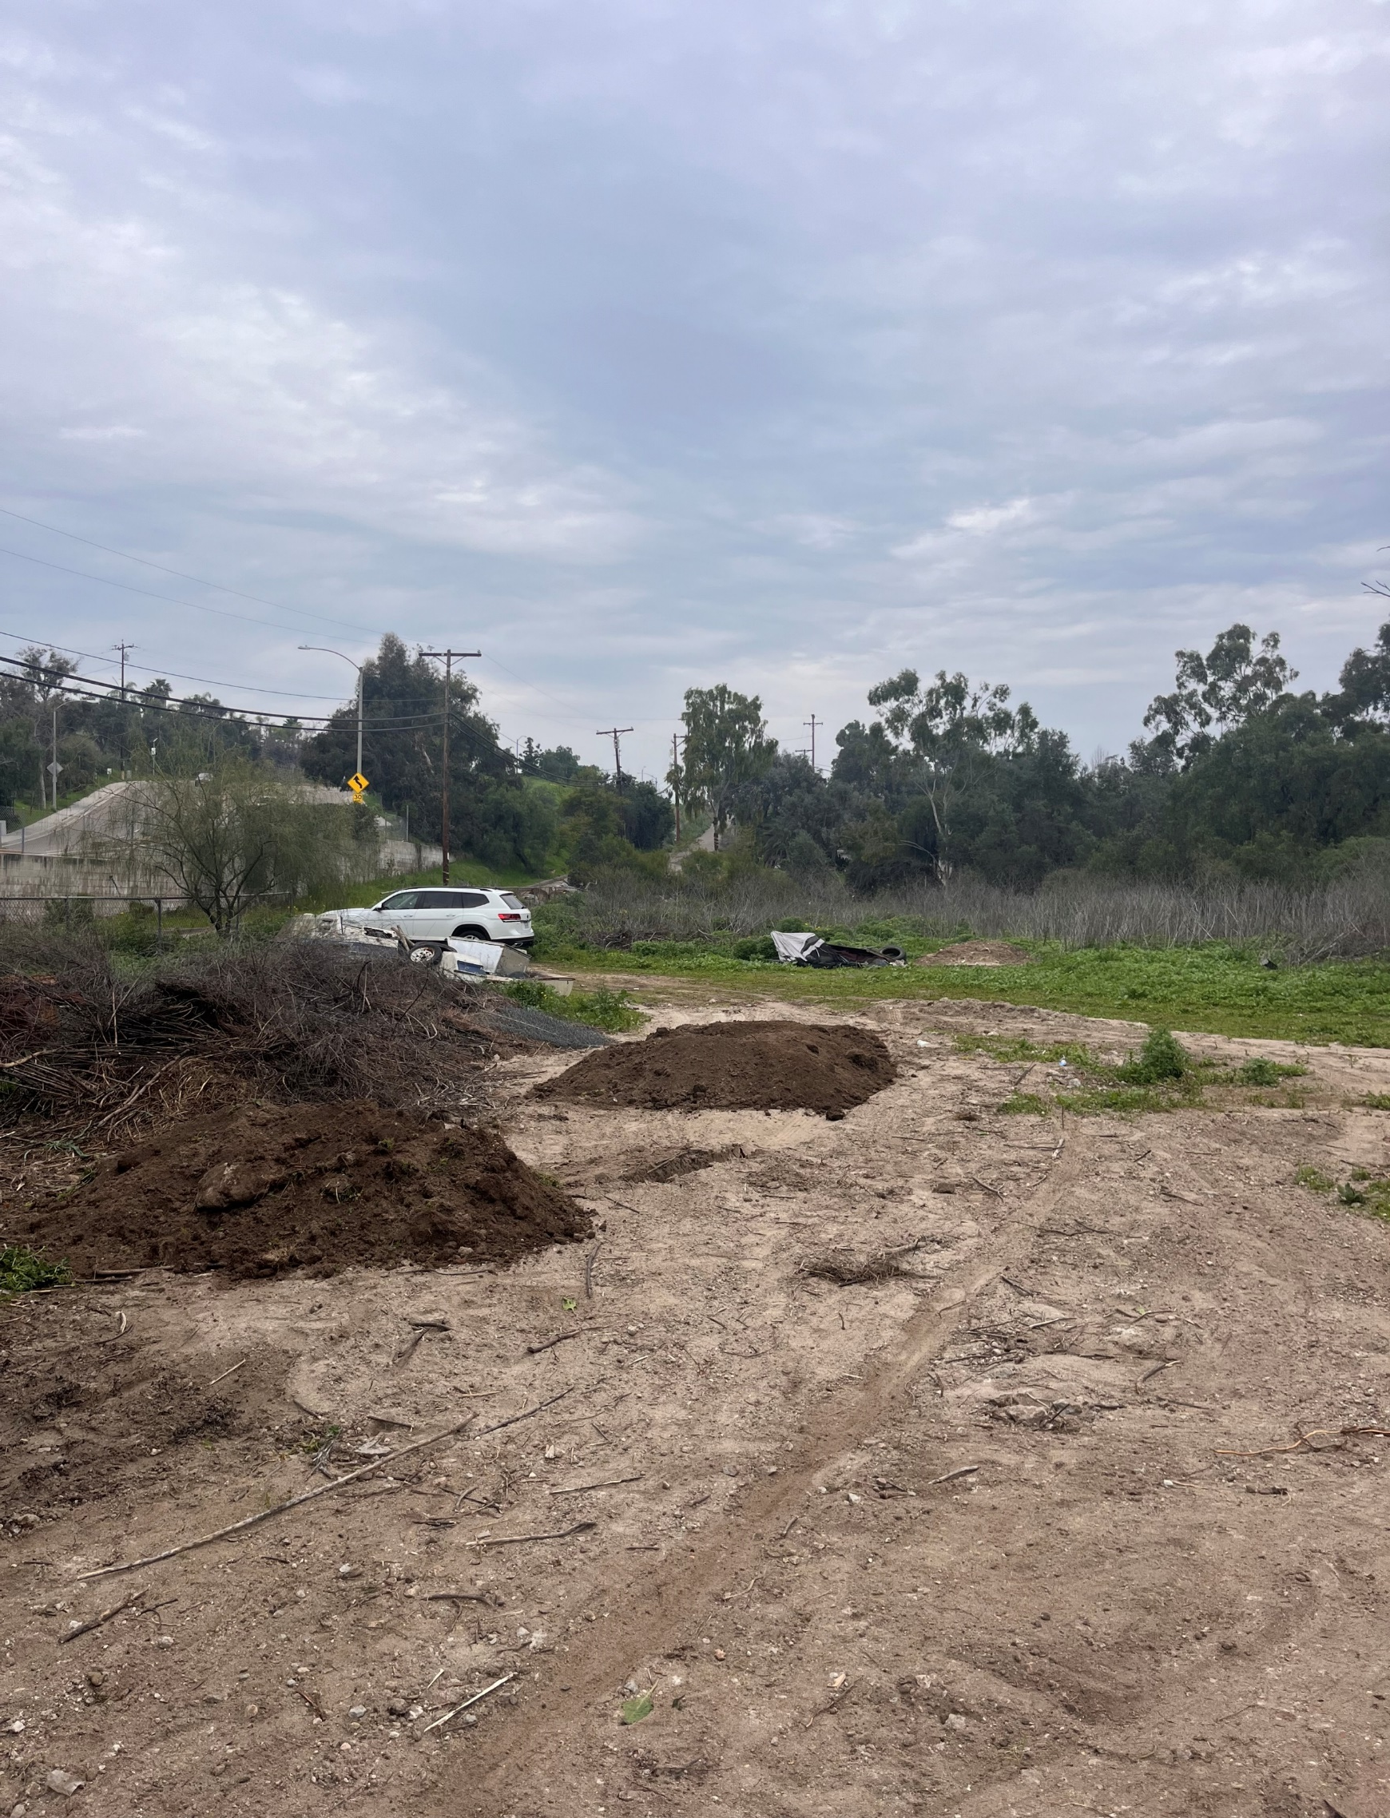

Slide 12
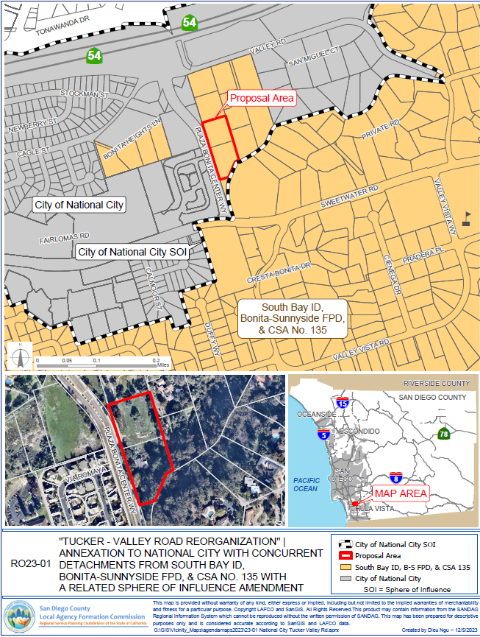
Agenda Item 7a
“Tucker – Valley Road Reorganization”
Annexation to National City with Concurrent Detachments from South Bay ID, Bonita-Sunnyside FPD, and CSA No. 135, and Related Sphere of Influence Amendment (RO23-01)

Slide 13
Recommendation :
Approve reorganization (no modifications) + sphere amendment to Bonita Sunnyside FPD
Waive L-106
Approve standard conditions + waiver protest proceedings
Approve exemption finding under CEQA + adopt MND findings

Slide 14
San Diego County
Local Agency Formation Commission
(LAFCO)
Commission Meeting
March 4th, 2024

Slide 15
Agenda Item 7b
Proposed Draft Workplan and Budget 2024‐2025

Slide 16
“Top 10” Projects

Slide 17
Remaining Projects

Slide 18
Proposed Budget

Slide 19
Proposed Budget

Slide 20
San Diego County
Local Agency Formation Commission
(LAFCO)
Commission Meeting
March 4th, 2024

Slide 21
Agenda Item 8a
LAFCO Oversight + Port of San Diego
Final Administrative Assessment
Receive Staff Presentation
Ask Clarifying Questions
Invite Public Comments
Commission Discussion
Consider Action on Recommendation

Slide 22
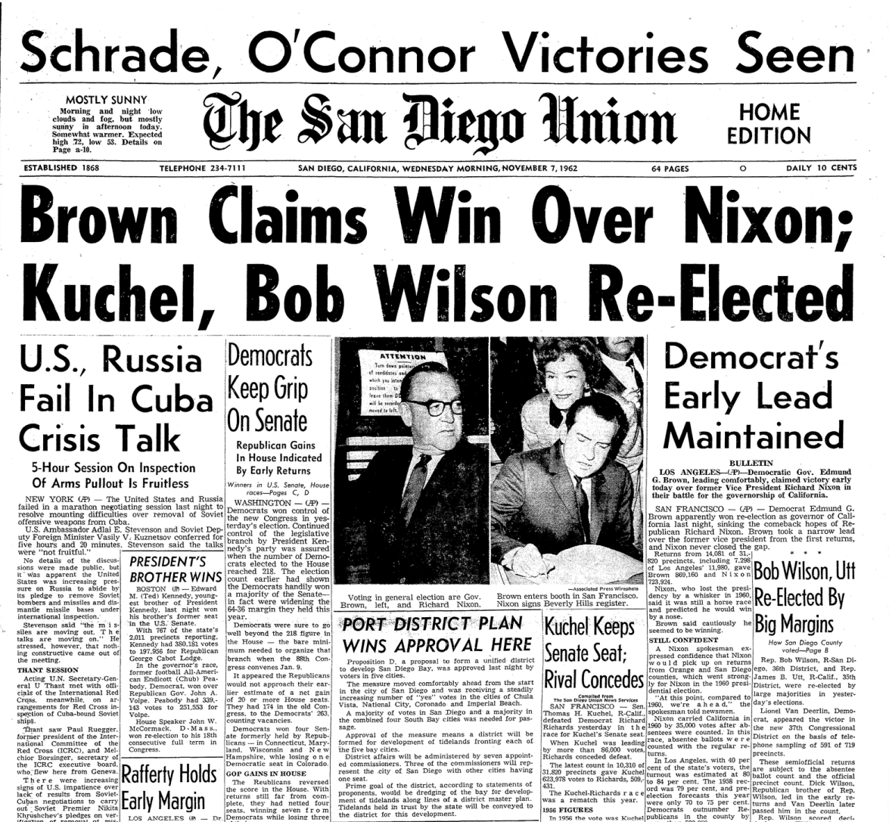
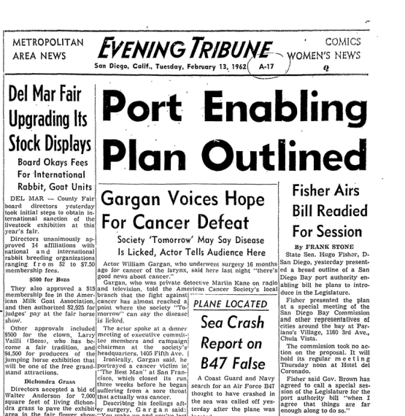
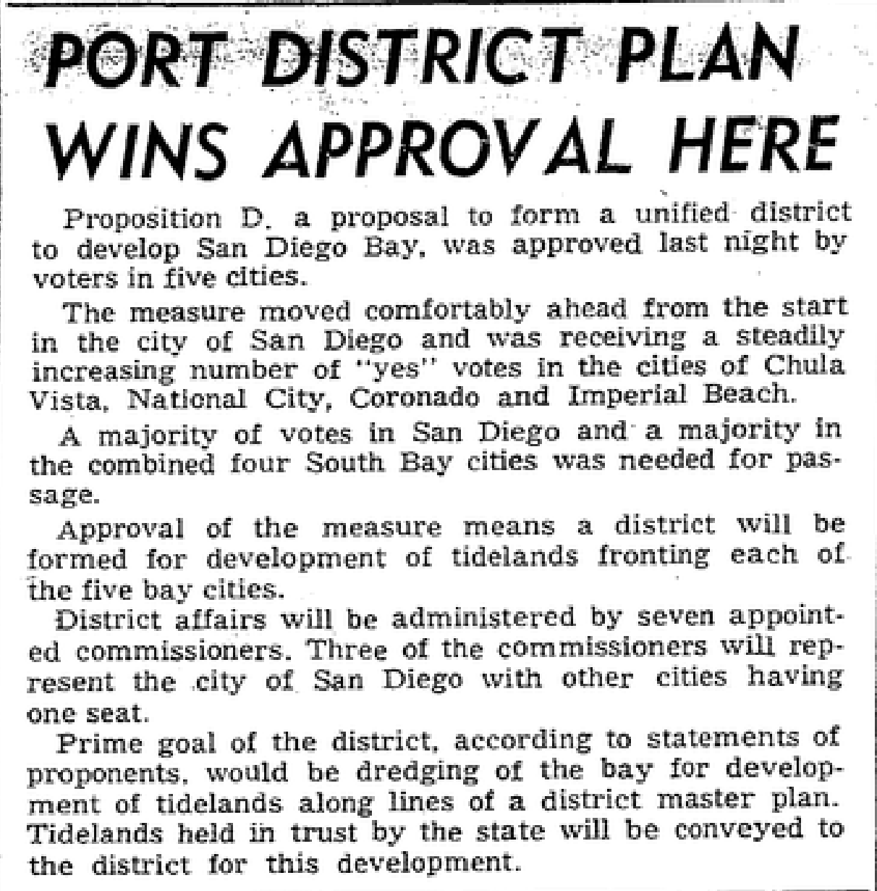
San Diego Unified Port District
Created by Voters in 1962
Utilized “Special” Enabling Act

Slide 23
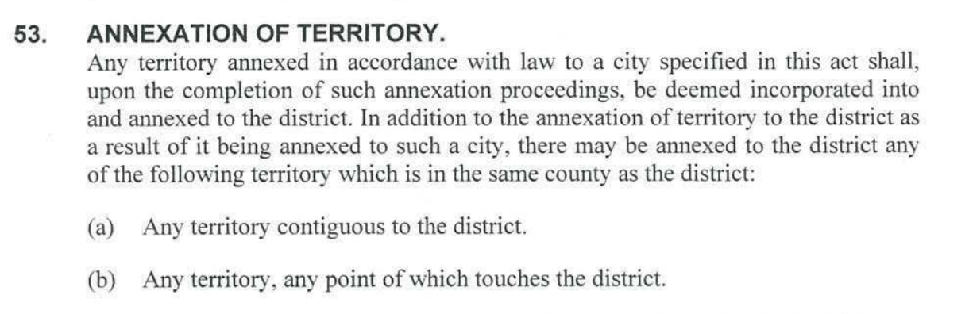
San Diego Unified Port District
Enabling Act Provisions
Harbor et al.
Match
5 Cities
Local Governance
Annexation Allowance

Slide 24
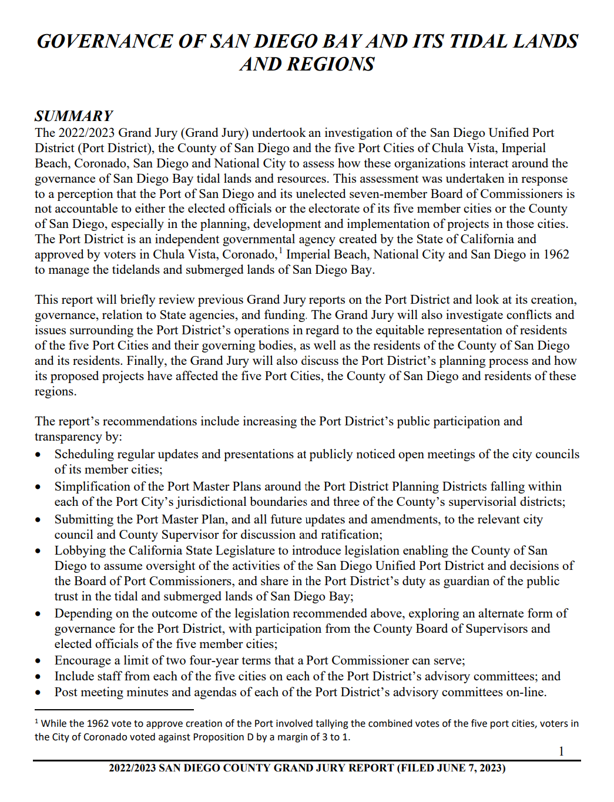
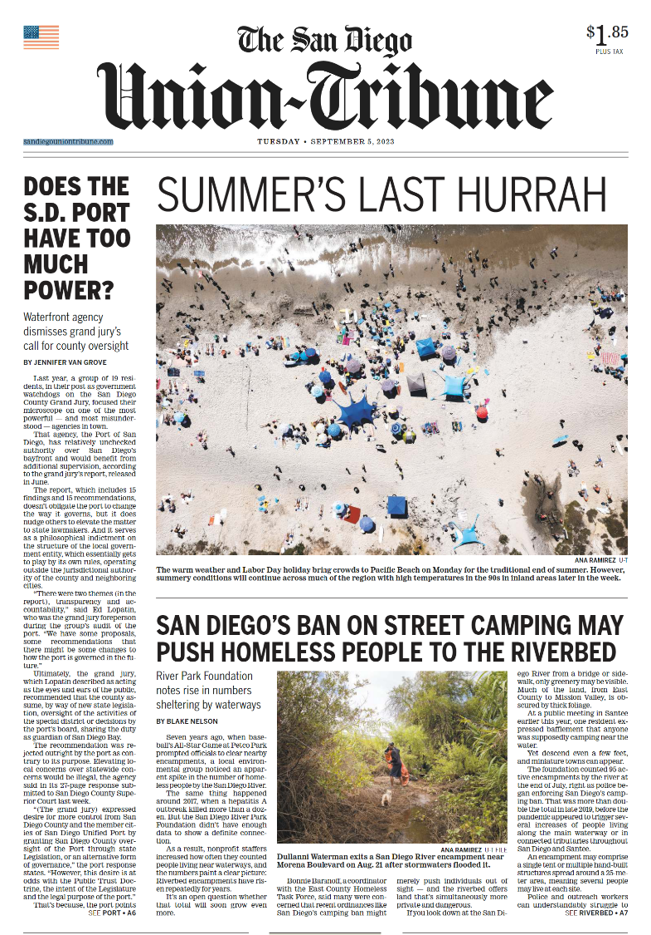
San Diego LAFCO…
Fast Forward to Summer + Fall 2023
Commission Request for Future Item:
Does LAFCO Oversight Apply to the SD Port?
June 2023
September 2023
October 2023

Slide 25
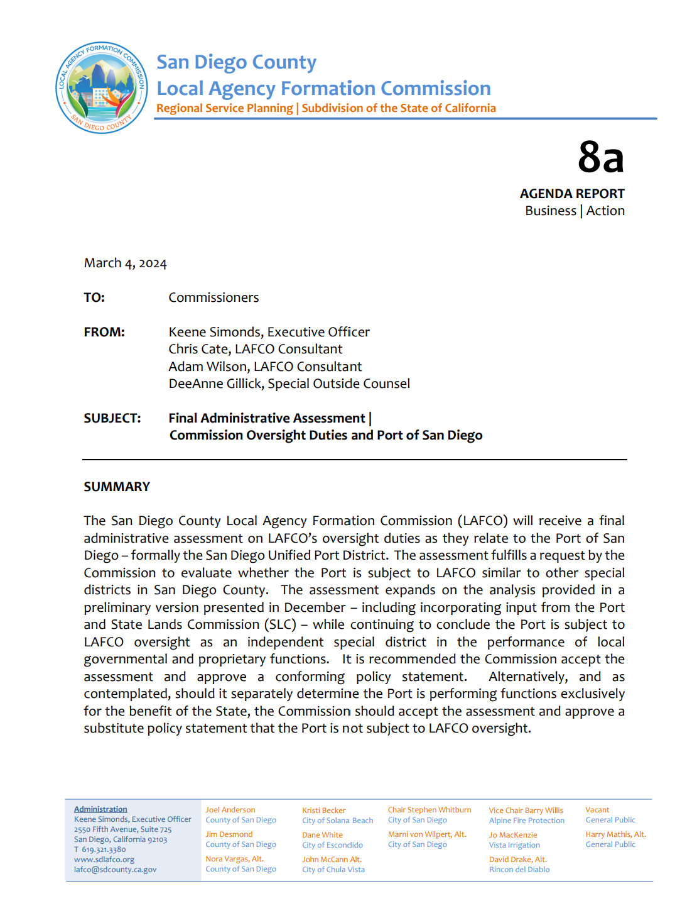
San Diego LAFCO…
Fast Forward to Today + Final Assessment
Premise
Port Performs
Local Governmental + Proprietary Services
Supporting Factors
1. CKH Covers “Special Act” Districts
2. SLC + LAFCO Oversight is Different
CKH Contemplates Dual SLC + LAFCO Oversight
Two Things are True:
Port Manages Public Trust Properties for
SLC (State) via Local Performances
Conclusion
Port is Subject to LAFCO Oversight

Slide 26
San Diego LAFCO…
What Does Oversight of the Port Mean Going Forward…
Act on Ministerial Annexations:
Provide Clear Procedures to Keep Port Boundary Coterminous with 5 Cities + File with SBE
Act on Discretionary Annexations:
Provide “Operational of Law” Function for Port to Annex Lands Beyond 5 Cities
Act Out-of-Agency Requests
Provide Authority for Port to Provide Extraterritorial Services
Act on Requests to Activate Latent Powers or Divest Active Powers
Provide Process for Port to Formally Add or Remove Service Functions/Classes
Act on Proposals to Detach, Consolidate, Merge, or Dissolve
Provide Process for Other Agencies + Public (Voters) to Initiate Boundary Actions to Port
Prepare Municipal Service Reviews + Act on Related Recommendations
Include Port in Periodical Studies Evaluating Effectiveness + Accountability to Community Needs

Slide 27
San Diego County
Local Agency Formation Commission
(LAFCO)
Commission Meeting
March 4th, 2024

Slide 28
Agenda Item 8b
Proposed Policy Update:
LAFCO Personnel Policies and Procedures

Slide 29
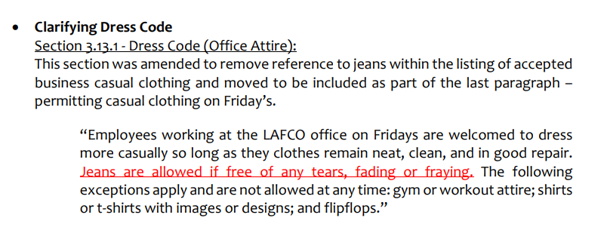
Dress Code – Casual Friday’s

Slide 30
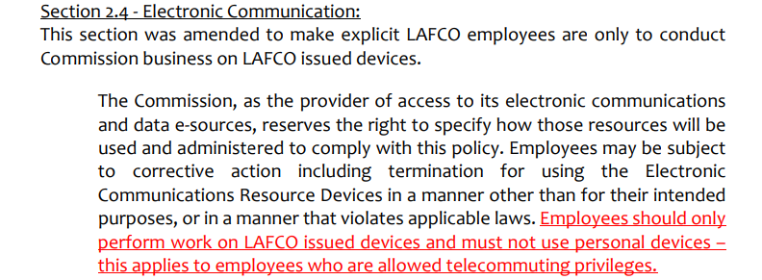
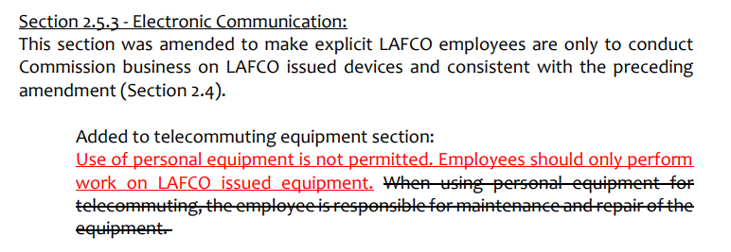
Limiting Use of Personal Equipment

Slide 31
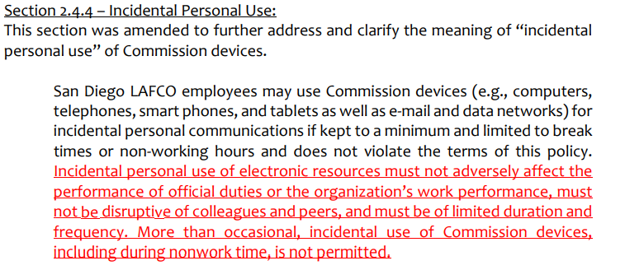
Addressing Incidental Use:
Commission Devices

Slide 32
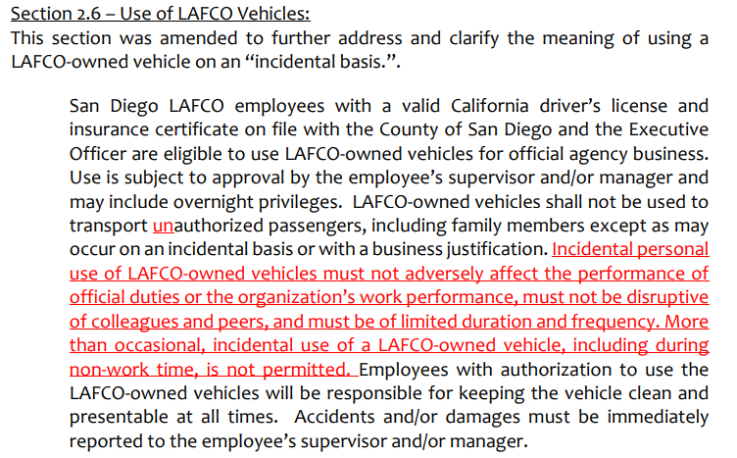
Addressing Incidental Use:
LAFCO-Vehicle

Slide 33
San Diego County
Local Agency Formation Commission
(LAFCO)
Commission Meeting
March 4th, 2024

Slide 34
Agenda Item 8e
SALC 2.0 Update

Slide 35
Agenda Item 8e | SALC 2.0 Update
Sustainable Agricultural Lands Conservation Planning Grant
Awarded $450,000 grant December 2022
San Diego LAFCO & San Diego County PDS
Accomplishments to Date:
Established MOU w/PDS
Established Key Partnerships
Began work on Tasks 1-5

Slide 36
Started 5/6 Tasks
Task 2 (Market Analysis)
Developing criteria, selecting 4 study crops: Avocados, Lemons, Strawberries, Tomatoes
Criteria focused on economic, environmental, social sustainability
Task 4 (Outreach & Education)
Rick engineering to hold series of producer/stakeholder meetings and aid in the Market Analysis

