Slide 1
Agenda Item 8a
LAFCO Oversight + Port of San Diego
Final Administrative Assessment
Receive Staff Presentation
Ask Clarifying Questions
Invite Public Comments
Commission Discussion
Consider Action on Recommendation

Slide 2
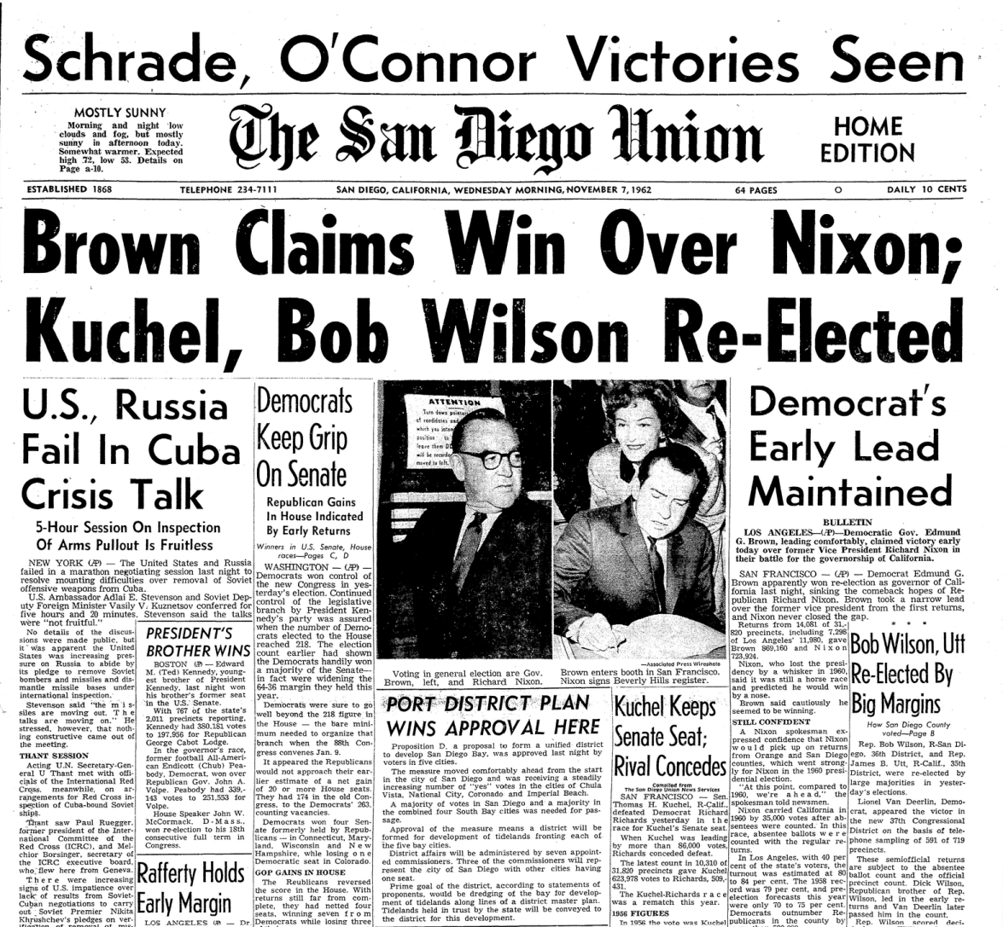
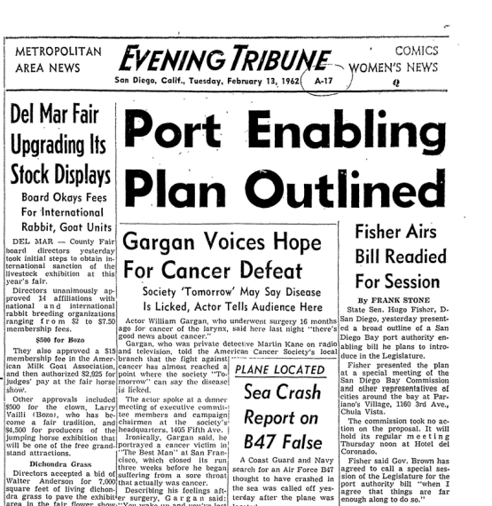
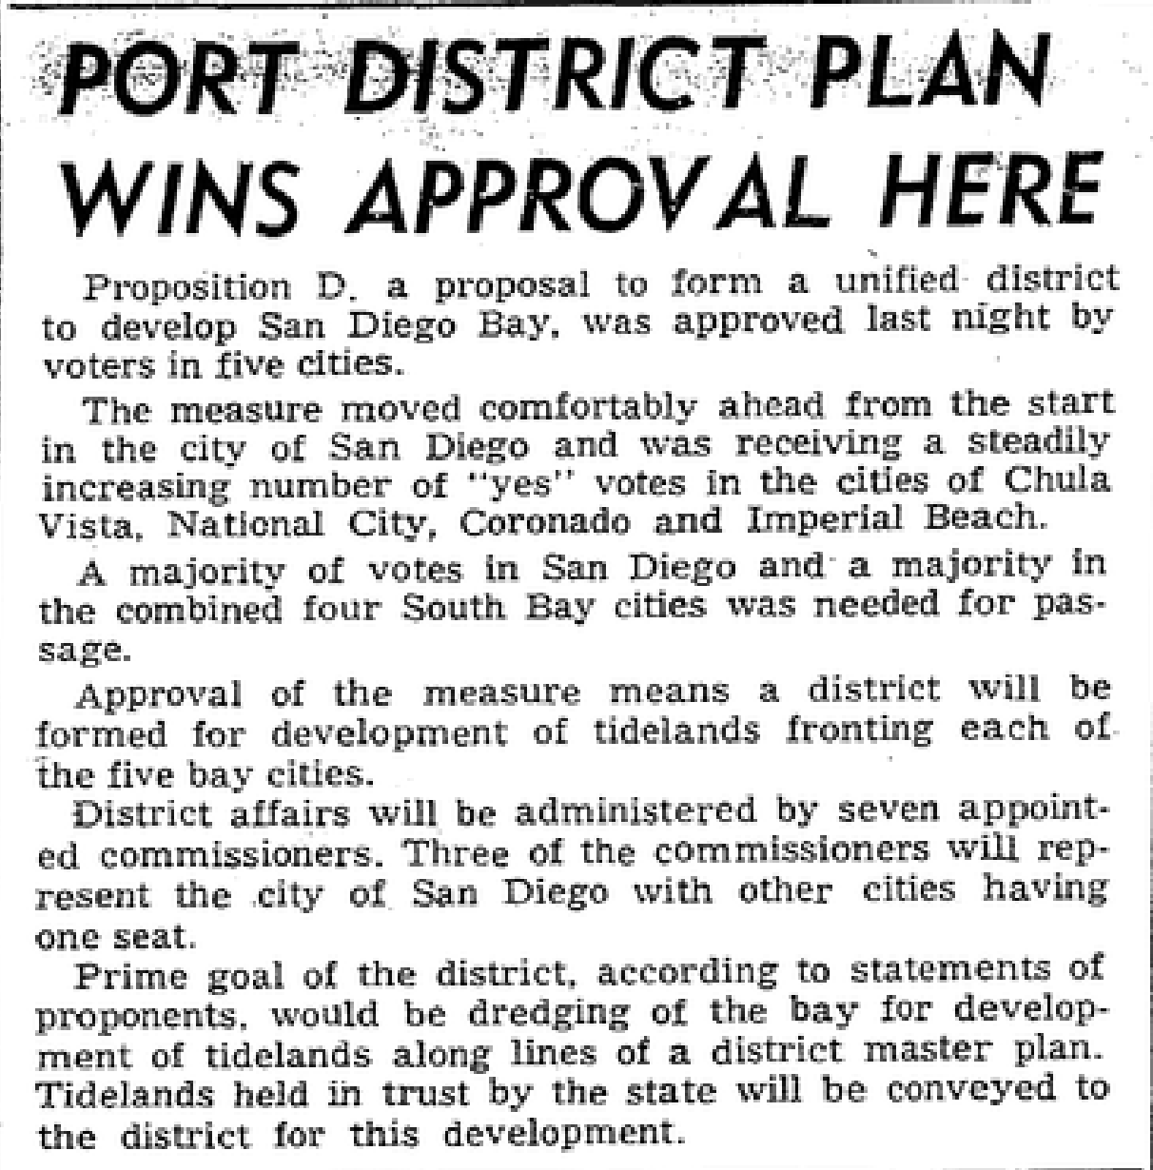
San Diego Unified Port District
Created by Voters in 1962
Utilized “Special” Enabling Act

Slide 3
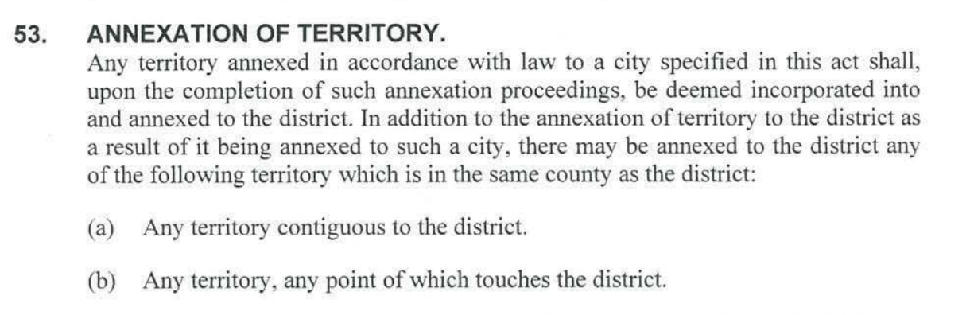
San Diego Unified Port District
Enabling Act Provisions
Harbor et al.
Match
5 Cities
Local Governance
Annexation Allowance

Slide 4
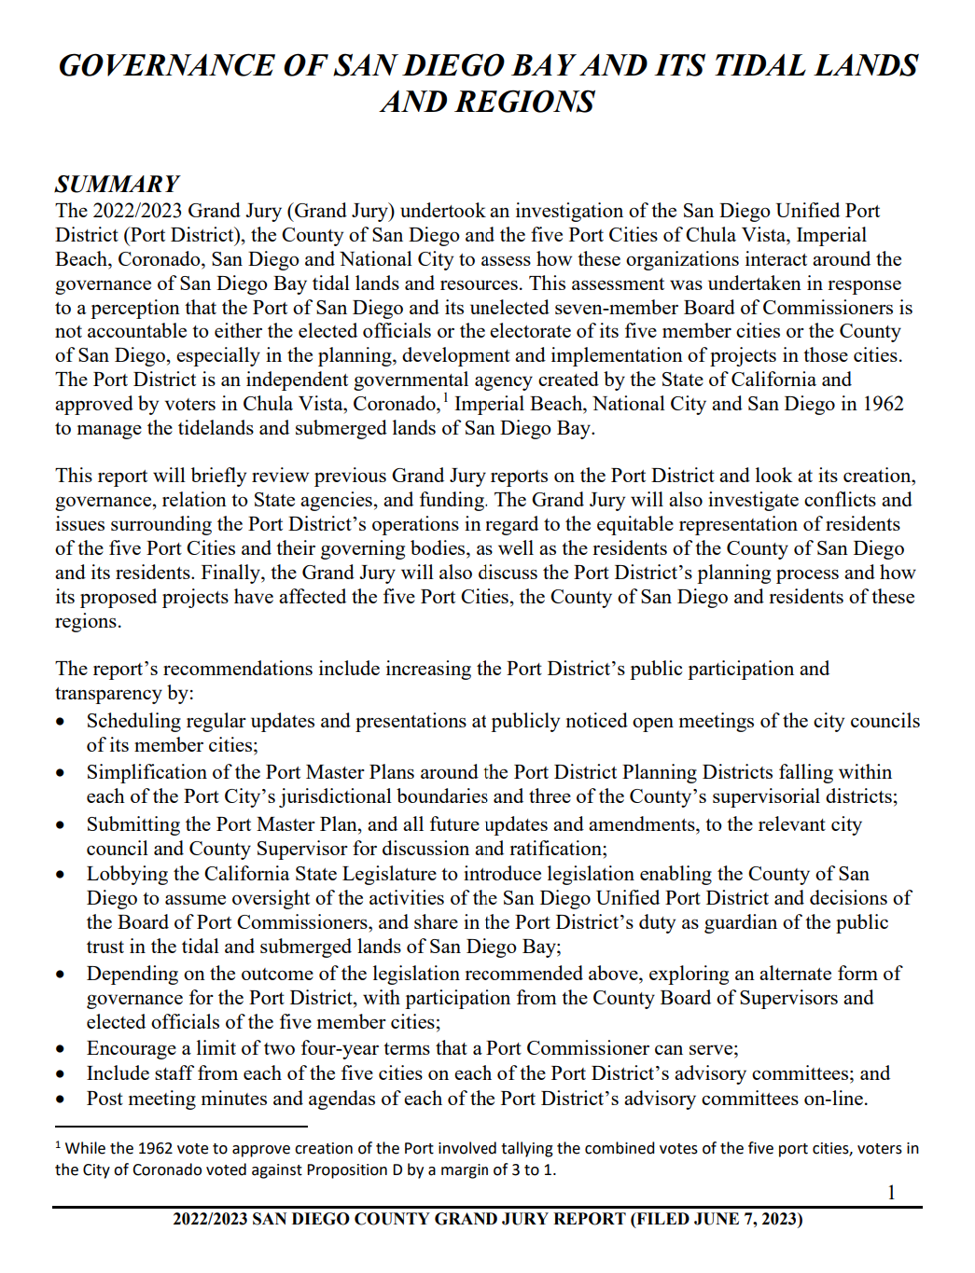
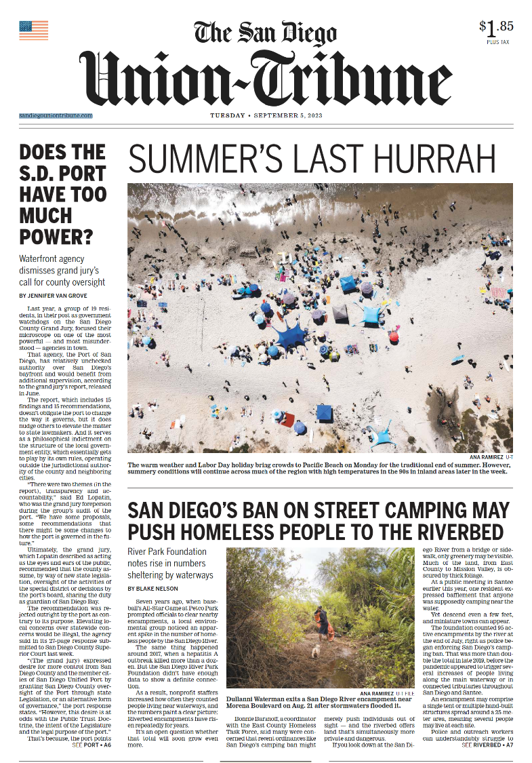
San Diego LAFCO…
Fast Forward to Summer + Fall 2023
Commission Request for Future Item:
Does LAFCO Oversight Apply to the SD Port?
June 2023
September 2023
October 2023

Slide 5
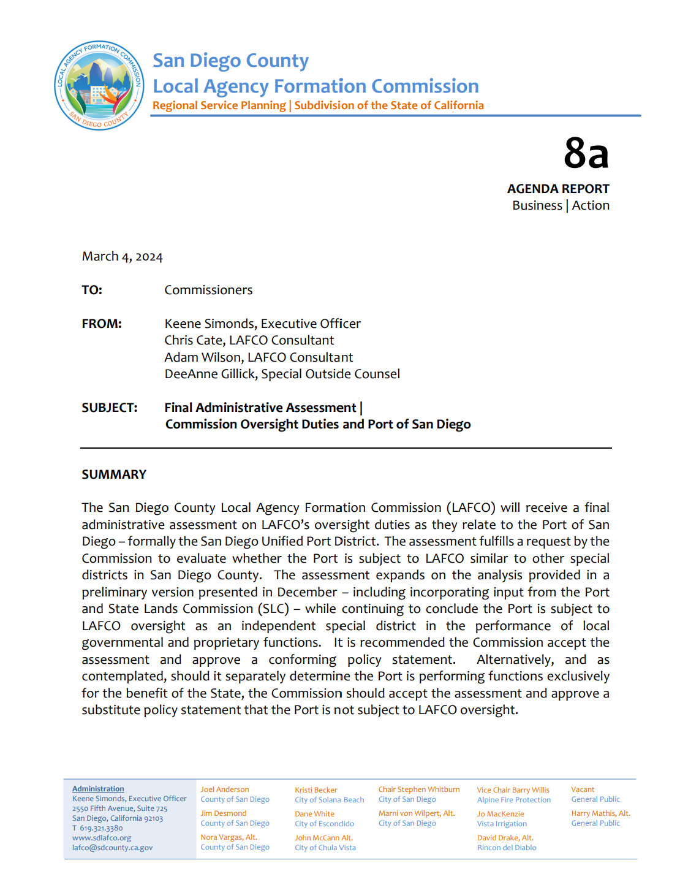
San Diego LAFCO…
Fast Forward to Today + Final Assessment
Premise
Port Performs
Local Governmental + Proprietary Services
Supporting Factors
1. CKH Covers “Special Act” Districts
2. SLC + LAFCO Oversight is Different
CKH Contemplates Dual SLC + LAFCO Oversight
Two Things are True:
Port Manages Public Trust Properties for
SLC (State) via Local Performances
Conclusion
Port is Subject to LAFCO Oversight

Slide 6
San Diego LAFCO…
What Does Oversight of the Port Mean Going Forward…
Act on Ministerial Annexations:
Provide Clear Procedures to Keep Port Boundary Coterminous with 5 Cities + File with SBE
Act on Discretionary Annexations:
Provide “Operational of Law” Function for Port to Annex Lands Beyond 5 Cities
Act Out-of-Agency Requests
Provide Authority for Port to Provide Extraterritorial Services
Act on Requests to Activate Latent Powers or Divest Active Powers
Provide Process for Port to Formally Add or Remove Service Functions/Classes
Act on Proposals to Detach, Consolidate, Merge, or Dissolve
Provide Process for Other Agencies + Public (Voters) to Initiate Boundary Actions to Port
Prepare Municipal Service Reviews + Act on Related Recommendations
Include Port in Periodical Studies Evaluating Effectiveness + Accountability to Community Needs

