Slide 1
“North Avenue Estates Reorganization” (RO18-06) Annexation to the City of Escondido Concurrent Detachments from : County Service Area No. 135 (Regional Communications) Deer Springs Fire Protection District
Project Manager
Robert Barry
San Diego LAFCO
October 1, 2018

Slide 2
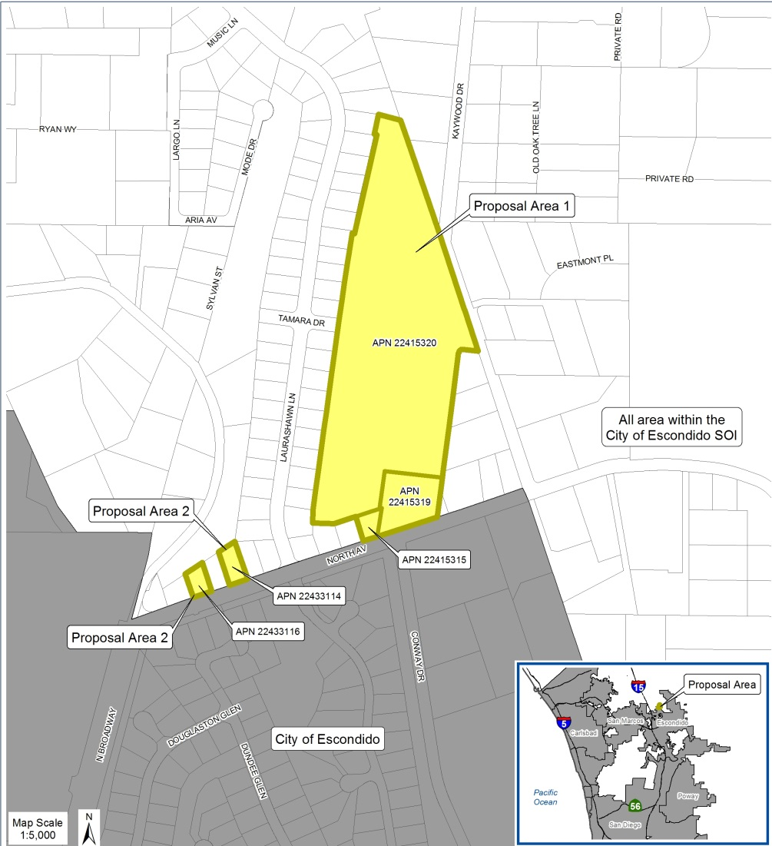
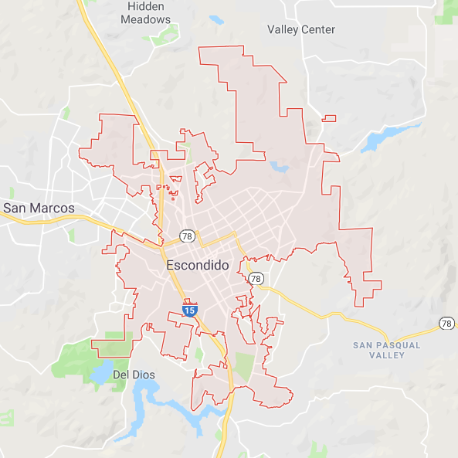
Affected Territory Area A - Three Parcels - One Parcel Developed with SFR * - Two Parcels are Undeveloped; Subject to 39-lot Subdivision Area B - Two Parcels - Both Developed with SFR * * Developed Parcels Already Connected to City Wastewater

Slide 3
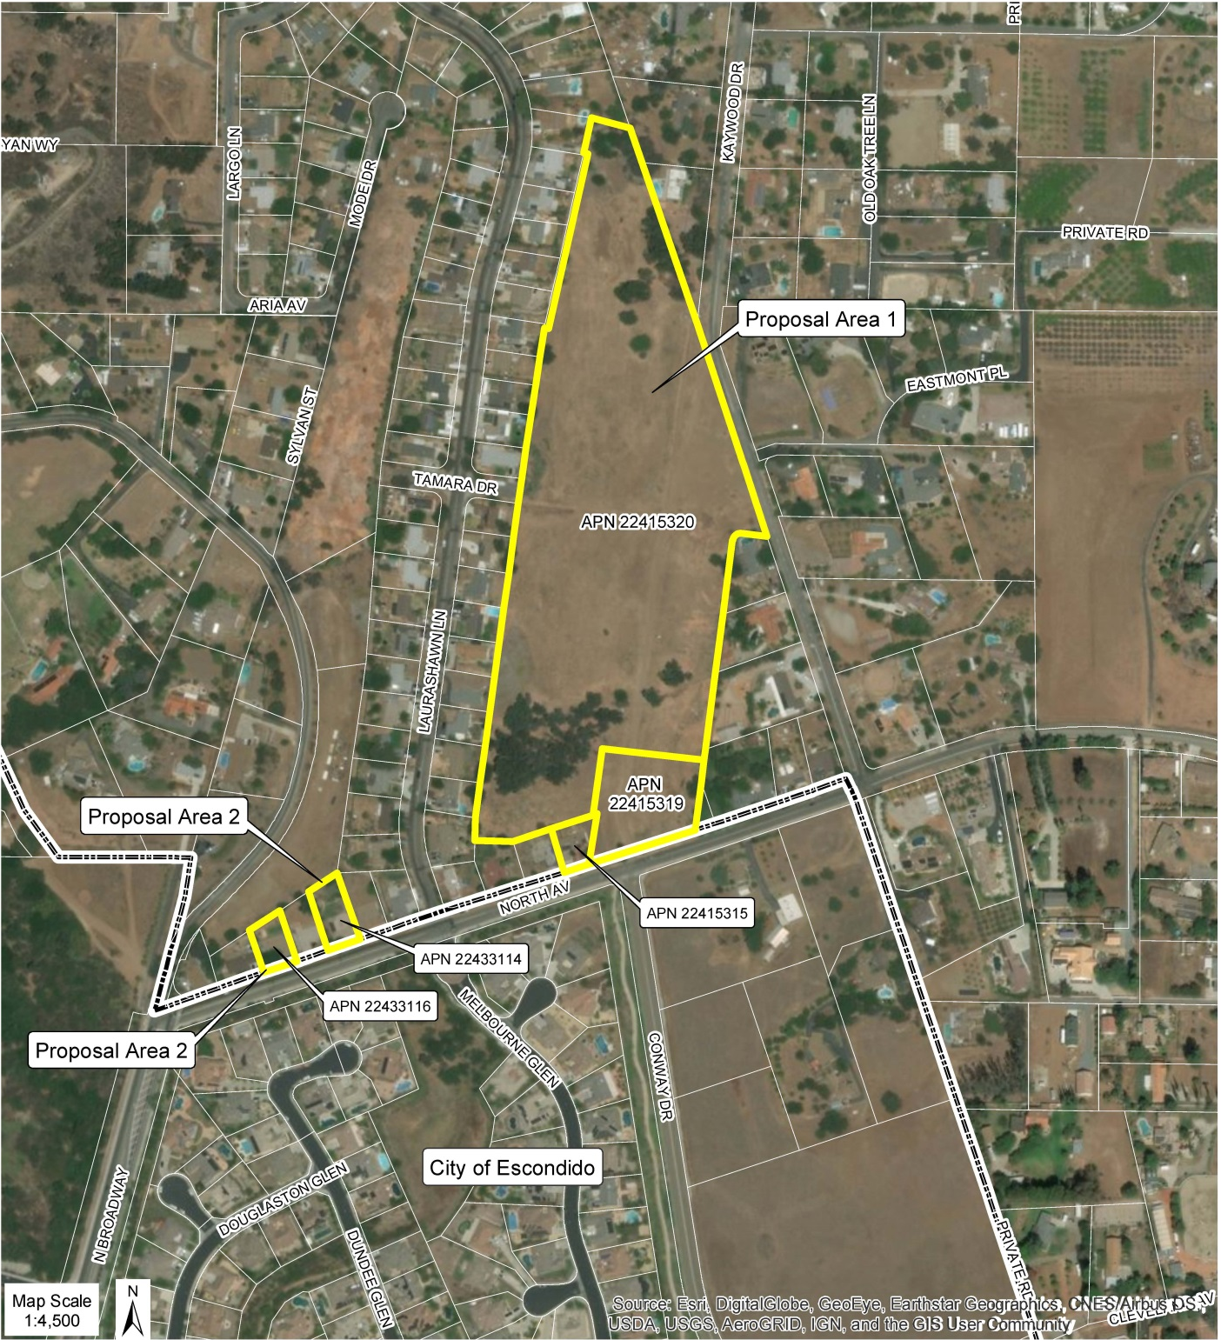
Discussion Adjacent Properties Local Drainage High Groundwater Septic Systems Deer Springs FPD Detachment

Slide 6
Development Project 34 SFR – 39 lots Drainage Improvements 12.5-ft Buffer Area Geotechnical Study: Groundwater Flow to S-SW DEH Review: No Impacts from Project Grading Operations Local Area within Escondido 2030 Wastewater Service Area

Slide 7
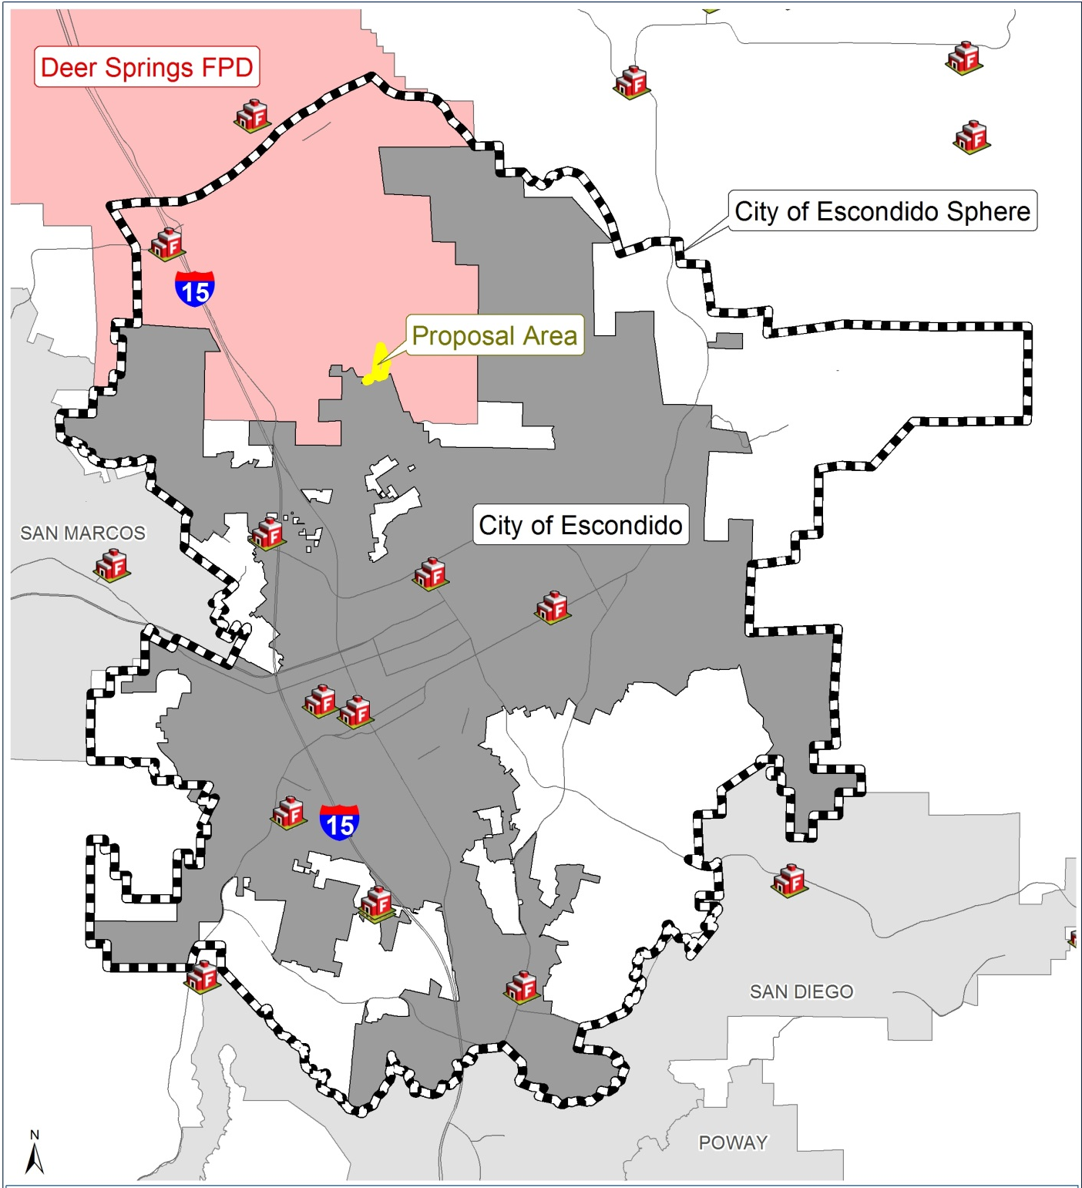
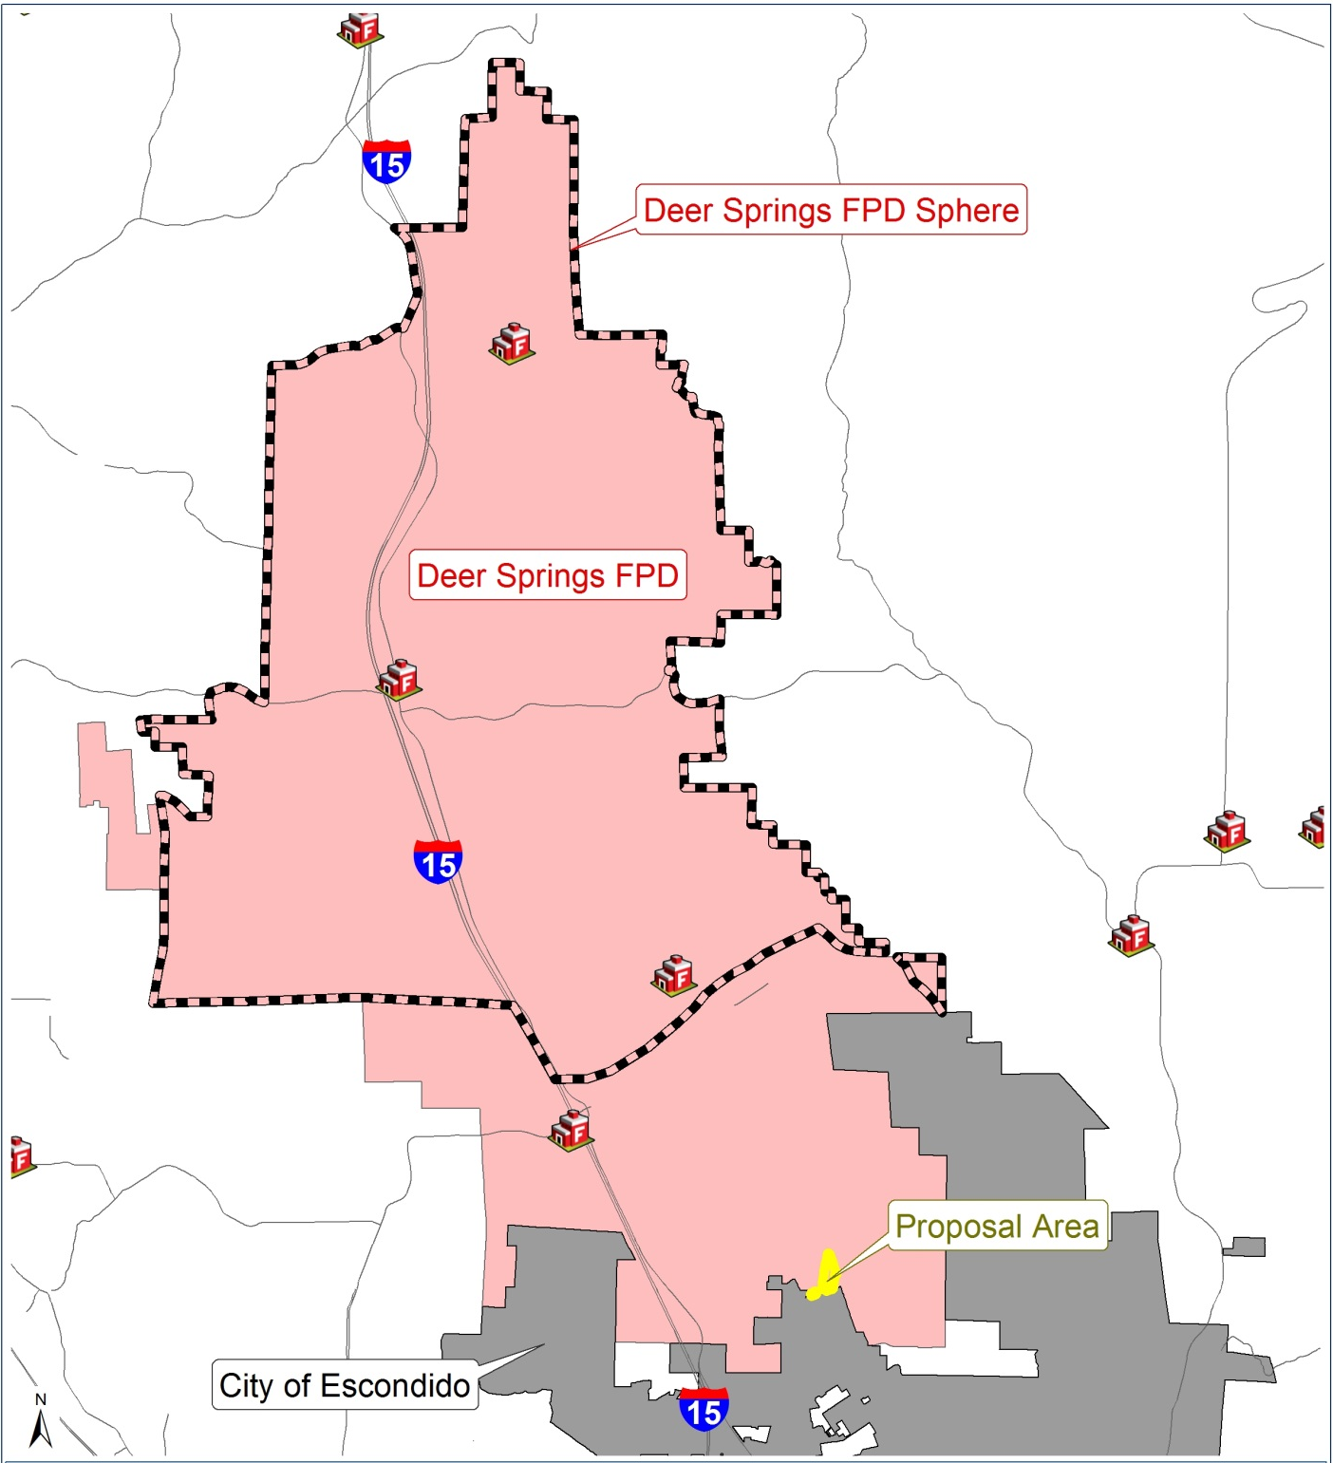

Slide 8
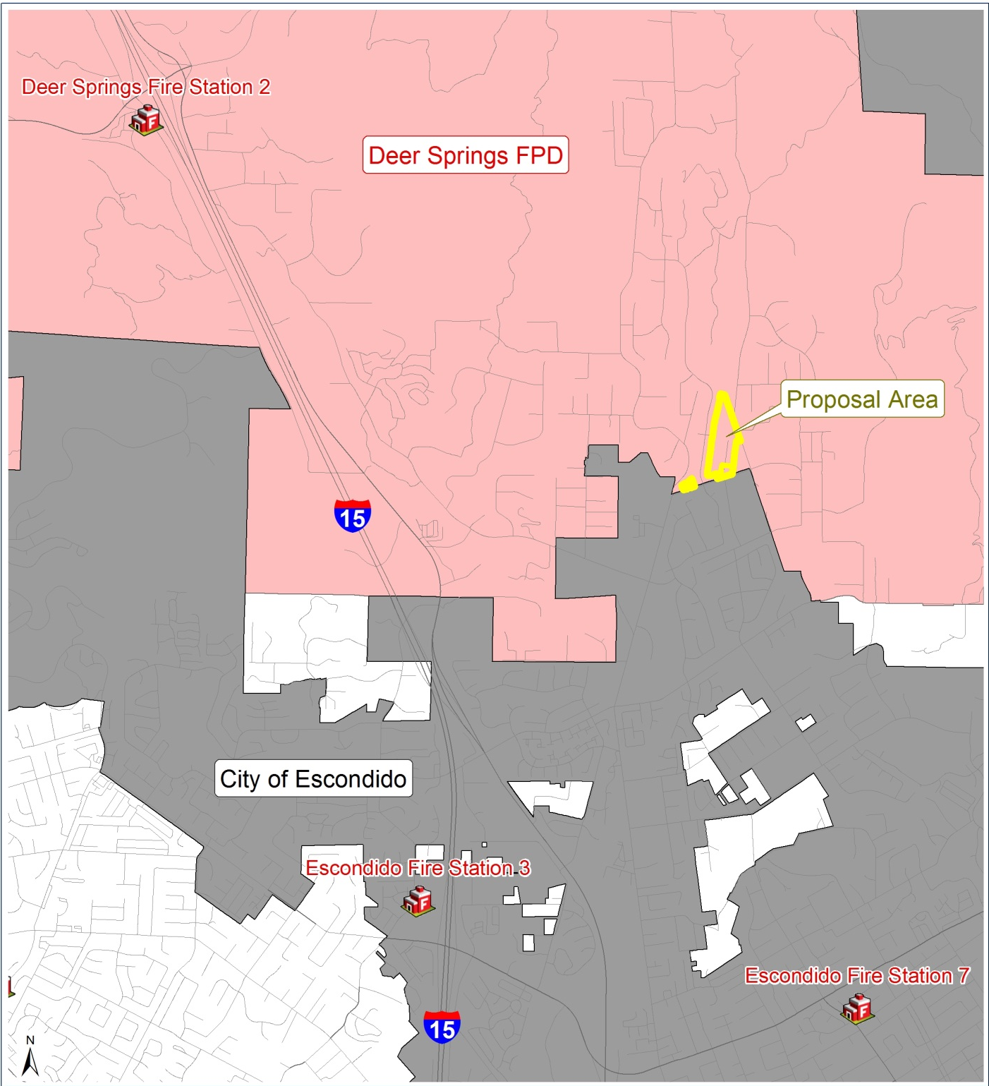
Fire Protection Deer Springs FPD Station No. 2 1321 Deer Springs Road approximately 3.9 miles from the affected territory City of Escondido Fire Station No. 3 1808 North Nutmeg Street approximately 2.8 miles from the affected territory

Slide 9
Recommendation
Accept MND/Addendum by Escondido as responsible agency under CEQA
Approve the “North Avenue Estates Reorganization” involving annexation to Escondido with concurrent detachments from CSA No. 135 and the Deer Springs Fire Protection District
Waive protest proceedings (100% consent of affected landowners)
Apply standard terms and conditions

Slide 10
“North Avenue Estates Reorganization” (RO18-06) Annexation to the City of Escondido Concurrent Detachments from : County Service Area No. 135 (Regional Communications) Deer Springs Fire Protection District
Project Manager
Robert Barry
San Diego LAFCO
October 1, 2018

