Slide 1
Combined Public Hearing | CSA No. 115 Reorganization (a) Reorganization No. 1 for San Miguel Consolidated FPD (b) Reorganization No. 2 for Lakeside FPD
Executive Officer
Keene Simonds
Project Manager
John Traylor
San Diego LAFCO
October 1, 2018

Slide 2
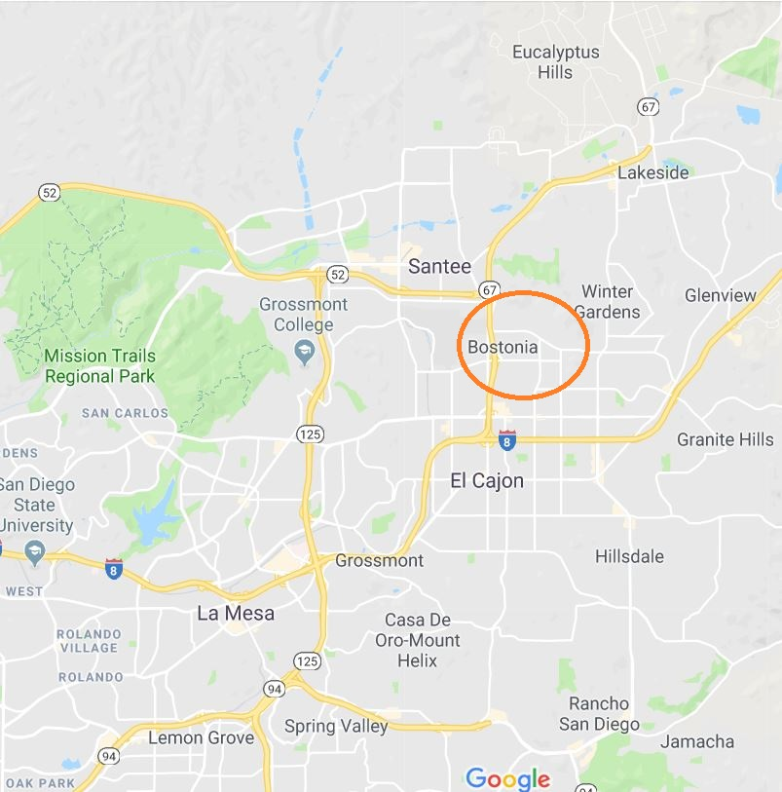
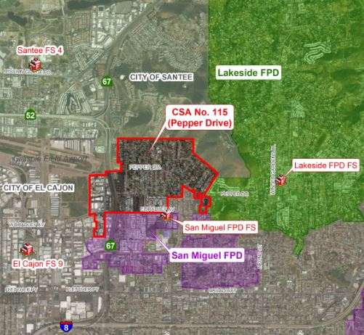
Affected Territory… entirely unincorporated approximately 441 acres 4,900 estimated residents 2,496 registered voters

Slide 3
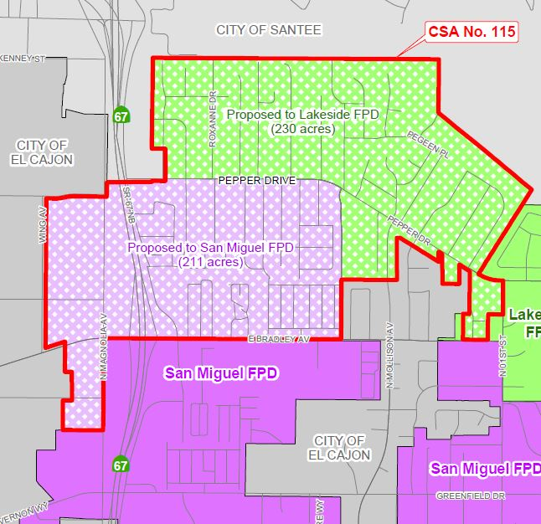
Joint-Approach… compromise replaces competition agree to “split” annexation generally along Pepper Drive lands north to Lakeside FPD lands south to San Miguel FPD equal split of property taxes
Proposed Split | Map One

Slide 4
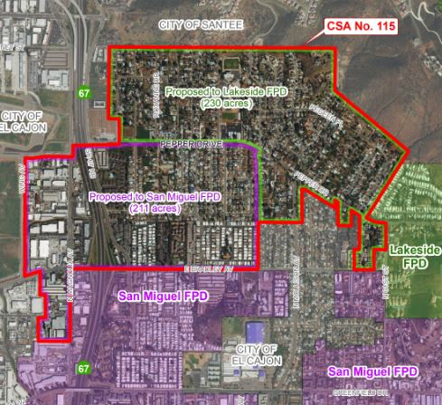
Joint-Approach… compromise replaces competition agree to “split” annexation generally along Pepper Drive lands north to Lakeside FPD lands south to San Miguel FPD equal split of property taxes
Proposed Split | Map Two

Slide 5
Today’s Hearing… receive staff presentation hear from the applicants hear from the public deliberate merits consider actions
6 Actions Needed for Proposal to Proceed…
Amend Lakeside’s Sphere to Include Northern Portion
Amend San Miguel’s Sphere to Include Southern Portion
Dissolve CSA No. 115
Annex Northern Portion to Lakeside FPD
Annexation Southern Portion to San Miguel FPD
Eliminate Existing Special Study Areas for Both FPDs

Slide 6
Focus of Analysis… State required factors local topics of Interests
5 Local Topics of Interests…
Confirmation of Modified Boundaries | Tax Exchange
Relocation of San Miguel’s Fire Station
Actual Service Responses within CSA No. 115
CSA No. 135 as an Alternate Service Provider
San Miguel’s Staffing Transition and Finances

Slide 7
Recommendation…
Approve the Combined Proposal…
Without Further Modifications
With Terms
Subject to Protest Proceedings

